Slide 1
Chapter 18
AI and Cancer Precision Medicine
Jan 10, 2024

Slide 2
Outline of This Lecture
1, AI and cancer big data
2, Cancer driver analysis
mutation driver analysis: Mutsig
CNA driver analysis: GISTIC
3, Mutational signature
Mutational processes and mutational signatures
SBS signature
CNA signature
4, Cancer precision therapy
Tumor vaccine
Neoantigen vaccine
Bispecific antibody

Slide 3
数据类型 | 技术手段 | 简要介绍
DNA突变 | 全基因组或全外显子测序 | 揭示DNA突变，拷贝数变化，DNA非编码突变和大型的结构变异。全外显子测序可以关注蛋白质编码区域的变化。单细胞测序可以查看单个细胞的基因组
染色质可及性 | ATAC-seq或者DNaseI-seq | 染色质的可及性反应着DNA的调控元件的活性。同个细胞条形码技术，ATAC-seq可以在单细胞水平上检测
组蛋白修饰 | CHIP-seq | 用于确定具有不同修饰的 DNA 结合蛋白或组蛋白的全基因组位置。
DNA甲基化 | 亚硫酸盐测序和BeadChip | 亚硫酸氢盐将未甲基化的胞嘧啶转化为尿嘧啶，再加上测序或 BeadChip，可以对 DNA 甲基化模式进行全基因组分析
转录组学 | 微阵列 | 揭露不同病人样本类型的基因表达水平
 | RNA测序 | 揭露不同病人样本类型的基因表达水平
 | 空间转录组技术 | 基于位置和条形码生成具有空间位置信息的基因表达数据
蛋白质组学 | 质谱法 | 在基因组规模上分析大量样本中的蛋白质表达和磷酸化
 | 蛋白芯片 | 在一些有抗体的靶标上分析蛋白质表达和磷酸化
 | CITE-seq | 基于带有DNA条形码标记的抗体，在单细胞水平同时检测细胞表面的蛋白质信息与胞内转录组信息
 | 流式细胞术 | 基于带有荧光标记的抗体，在单细胞水平上检测少量目标的蛋白质表达
 | 质谱流式术 | 基于带有同位素的抗体，在单细胞水平上检测大量目标的蛋白质表达
 | CODEX | 基于带有核苷酸标记的抗体，对带有空间信息和单细胞水平分辨率的组织切片上超过30种蛋白的检测和分析
代谢组学 | 核磁共振 | 可以根据原子的共振频率及其在磁场中的直接化学环境揭示患者样本中的代谢物。
 | 质谱法 | 根据质荷比和已知代谢物数据库中的比较揭示样品中的代谢物

Slide 4
项目名称 | 样本类型 | 数据类型 | 数据库大小 | 简要描述
TCGA | 原发性癌症、匹配的正常样本、一些转移性样本 | 基因表达、DNA 突变、DNA 甲基化、染色质可及性、CNA、蛋白质表达、组织病理学图像 | 来自 33 种癌症类型的 11,315 个癌症基因组 | 由美国国家癌症研究所和美国国家人类基因组研究所主持
ICGC | 原发性癌症、匹配的正常样本、一些转移性样本 | 基因表达、DNA突变、DNA甲基化、CNA、蛋白表达 | 来自 22 种癌症类型的 25,000 个癌症基因组 | 通过全球癌症基因组学合作，用于记录驱动常见肿瘤类型的体细胞突变
PCAWG | 样本来源于TCGA和ICGC | 来自全基因组测序的 DNA 变异 | 来自 38 种肿瘤类型的 2,658 个癌症基因组 | 揭示了 288,457 个跨拓扑关联域的结构变化
LINCS | 人类细胞系 | 治疗或遗传扰动后的差异表达 | 50 种细胞类型中的 140 万个基因表达谱，主要关注于大约 1,000 个标志性基因 | 探索细胞模型如何通过使用微阵列对化学或遗传扰动做出反应，这些微阵列聚焦于大约 1,000 个最能代表转录组变异的基因
CCLE | 人类肿瘤细胞系 | 基因表达、DNA 突变、启动子甲基化、CNA、代谢组学、药物敏感性、CRISPR/RNAi 全基因组筛选、一些靶标的蛋白质表达 | 1,072 个细胞系 | 提供人类癌细胞系数据百科全书
CPTAC | 人类肿瘤和正常组织 | 蛋白质表达和翻译后修饰 | 来自 14 个肿瘤部位的近 4,000 个样本 | 通过大规模蛋白质组基因组学了解癌症分子基础
Human Protein Atlas | 人类肿瘤，正常组织和细胞模型 | IHC 图像，基因表达 | 大多数蛋白质编码基因的 310 万张带注释的 IHC 组织图像，涵盖 17 种癌症类型 | 旨在使用 IHC 绘制肿瘤和组织中的所有人类蛋白质
GENIE | 人类肿瘤 | 外显子组突变集中于常见的癌症相关基因 | 来自 110 个癌症部位的 136,096 个病例 | 汇总了在常规医疗实践中从癌症患者那里获得的测序数据
CAMELYON | 转移性乳腺癌患者的前哨淋巴结 | H&E 染色载玻片 | 1,399 张带有转移区域病理学注释的whole-slide图像 | 评估用于自动检测和分类淋巴结全幻灯片图像中乳腺癌转移的新算法和现有算法的挑战
TARGET | 儿科癌症 | 基因表达、DNA 突变（全基因组和全外显子组测序）、DNA 甲基化 | 6,196 个癌症基因组，涵盖 9 种癌症类型 | 应用全面的基因组方法来确定导致儿童癌症的分子变化

Slide 5
项目名称 | 样本类型 | 数据类型 | 数据库大小
TCGA | 原发性癌症、匹配的正常样本、一些转移性样本 | 基因表达、DNA 突变、DNA 甲基化、染色质可及性、CNA、蛋白质表达、组织病理学图像 | 来自 33 种癌症类型的 11,315 个癌症基因组
ICGC | 原发性癌症、匹配的正常样本、一些转移性样本 | 基因表达、DNA突变、DNA甲基化、CNA、蛋白表达 | 来自 22 种癌症类型的 25,000 个癌症基因组
PCAWG | 样本来源于TCGA和ICGC | 来自全基因组测序的 DNA 变异 | 来自 38 种肿瘤类型的 2,658 个癌症基因组
LINCS | 人类细胞系 | 治疗或遗传扰动后的差异表达 | 50 种细胞类型中的 140 万个基因表达谱，主要关注于大约 1,000 个标志性基因
CCLE | 人类肿瘤细胞系 | 基因表达、DNA 突变、启动子甲基化、CNA、代谢组学、药物敏感性、CRISPR/RNAi 全基因组筛选、一些靶标的蛋白质表达 | 1,072 个细胞系
CPTAC | 人类肿瘤和正常组织 | 蛋白质表达和翻译后修饰 | 来自 14 个肿瘤部位的近 4,000 个样本
Human Protein Atlas | 人类肿瘤，正常组织和细胞模型 | IHC 图像，基因表达 | 大多数蛋白质编码基因的 310 万张带注释的 IHC 组织图像，涵盖 17 种癌症类型
GENIE | 人类肿瘤 | 外显子组突变集中于常见的癌症相关基因 | 来自 110 个癌症部位的 136,096 个病例
CAMELYON | 转移性乳腺癌患者的前哨淋巴结 | H&E 染色载玻片 | 1,399 张带有转移区域病理学注释的whole-slide图像
TARGET | 儿科癌症 | 基因表达、DNA 突变（全基因组和全外显子组测序）、DNA 甲基化 | 6,196 个癌症基因组，涵盖 9 种癌症类型

Slide 6
数据库名称 | 数据集 | 数据大小 | 简要描述
GDC | 20 个数据集合，包括 TCGA、TARGET、GENIE 和 CPTAC | 来自 67 个原发癌部位的 85,552 个病例 | 为癌症研究界提供一个统一的存储库，支持跨基因组研究的数据共享
IDC | 115 个数据集合，包括来自 TCGA、CPTAC 和其他项目 | 来自 21 个原发癌部位的 61,134个病例 | 将研究人员与公开可用的癌症成像数据联系起来，并提供与其他癌症研究数据共享集成的云计算环境
TCIA | 169 个数据集合，包括来自 TCGA、CPTAC 和其他项目的 | 来自 69 种疾病类型的 65,508 例病例，包括癌症和非癌症类型（例如 COVID-19） | 去识别化并托管癌症医学图像以供公众下载，但不能像 IDC 那样使用云计算。 IDC 收录了部分数据。 还包括一些私人数据收集
GEO | 177,063个数据系列，其中53,740 个包含“癌症”关键字 | 5,102,810 个样本，1,118,082 个样本在元数据中包含“癌症”关键字 | 托管来自各种研究的数据提交。
Array Express | 16,345 例实验，其中3,293 包含“癌症”关键字 | 894,309 个样本，其中 236,935 个在其元数据中包含“癌症”作为关键字 | 一个热门的的基因组学数据库
FDC | 81,883 个放在 GEO 和 Array Express 中人类数据集存 | 总共3,707,349个样本，不限于癌症 | 帮助研究人员在 GEO 和 Array Express 中注释元数据，以实现自动算法分析和新知识的发现

Slide 7
人工智能
人工智能
人工智能是计算机系统对人类智能过程
进行模拟的技术
机器学习
机器学习
机器学习是机器从经验中自动学习和改进的过程
无需人工编写程序来指定规则和逻辑
深度学习
深度学习
深度学习是机器学习的一种方法
其主要特点是利用多层非线性处理单元进行特征提取和转换

Slide 8
人工智能发展历史
1995
Cortes和Vapnik
提出了支持向量机 /
Freund和Schapire
提出了AdaBoost
1950
艾伦·麦席森·图灵提出“图灵测试”
定义了人工智能的标准
1979
汉斯·贝利纳打造的计算机程序
战胜双陆棋世界冠军
2006
杰弗里·辛顿等正式提出了深度学习的概念
2022
Open AI上线ChatGPT对话人工智能
1943
麦卡洛克和皮茨提出
神经元的数学模型
奠基了现代人工智能
1957
罗森布拉特实现了
“感知机” 神经网络模型
1974
沃伯斯首次
提出了误差反向传播
1986
辛顿等人先后提出了
多层感知器
与反向传播训练
相结合的理念
2001
布雷曼博士
提出随机森林
2013
变分自编码器
被提出
1930
1940
1950
1960
1970
1980
1990
2000
2010
2020
1989
乔治·西本科证明了
“万能近似定理” /
卷积神经网络出现
2012
AlexNet神经网络在ImageNet大获全胜
1968
爱德华·费根鲍姆
提出首个专家系统DENDRAL
1997
国际商业机器公司
深蓝超级计算机战胜了
国际象棋世界冠军 /
长短期记忆神经网络
被提出
2017
谷歌提出
Transformer
1956
达特茅斯学院人工智能夏季研讨会上
正式使用了人工智能这一术语
标志着人工智能学科的诞生
1982
约翰·霍普菲尔德
发明了霍普菲尔德网络
这是最早的RNN的雏形 /
日本第五代计算机项目开始

Slide 9
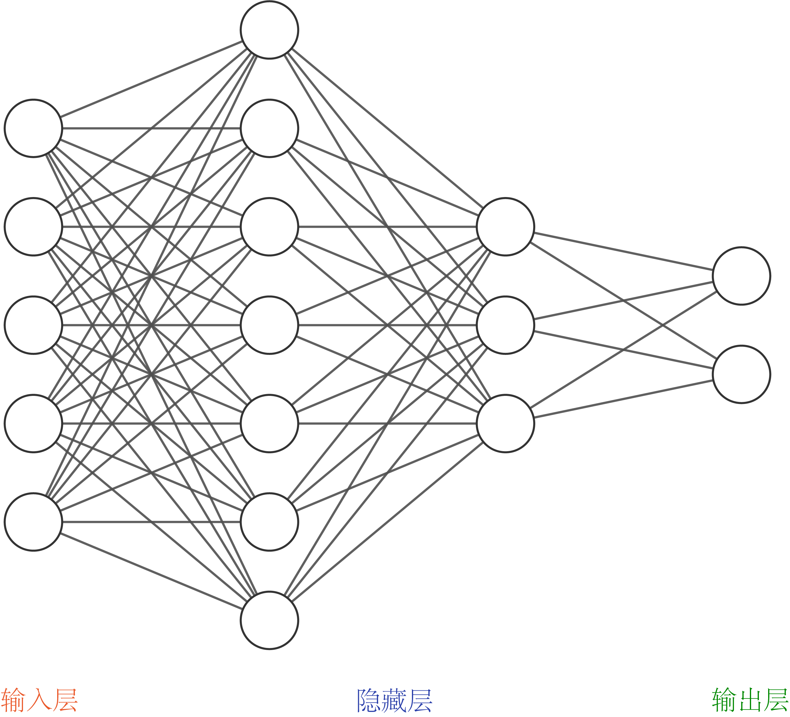
前馈神经网络

Slide 10
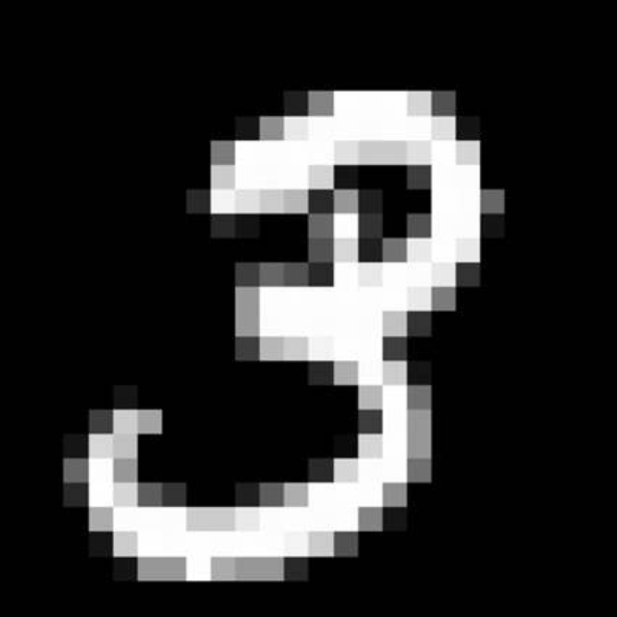
卷积神经网络
输入
卷积层
最大池化层
展平
全连接层

Slide 11
Major Questions of AI for Cancer
AI4Cancer主要研究内容
Diagnosis of actionable cancer, especially in early stage
Early cancer screening（癌症早筛）
Cancer monitoring（癌症监测，如微小残留病监测）
Cancer classification（癌症分型，包括预后分型、治疗分型）
Therapeutic treatment of cancer, especially late stage cancer
Cancer drug targets identification（癌症个性化药物靶点发掘）
Biomarkers for cancer treatments（癌症伴随诊断标志物）
Immune cell specificity prediction （癌症免疫受体特异性预测，如TCR、BCR、Ab、新抗原预测等）

Slide 12
Characteristics of cancer big data
癌症大数据特点
Small sample size
样本数量少
High data modal dimension
数据模态多、维度高

Slide 13
Small scale alteration (point mutation, small indel) drivers

Slide 14
MutSig
MutSig stands for "Mutation Significance". MutSig analyzes lists of mutations discovered in DNA sequencing, to identify genes that were mutated more often than expected by chance given background mutation processes.
Lawrence, M. et al. Mutational heterogeneity in cancer and the search for new cancer-associated genes. Nature 499, 214-218 (2013).

Slide 15
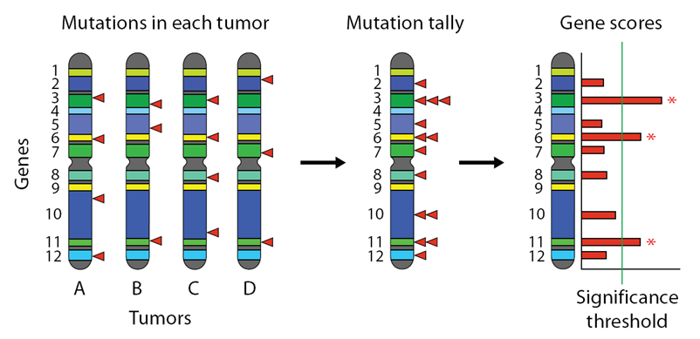
MutSig

Slide 16
MutSig has been evolving since the early days of clinical sequencing, and several versions have been in use:
MutSig1.0 assumed a constant background mutation rate (BMR) across the genome.
MutSig1.5 implemented a rudimentary estimate of per-gene background mutation rates from analyzing the silent (synonymous) mutations of each gene and the rough expression level of the gene.
MutSig2.0 This part of MutSig looks at two additional independent signals of positive selection in genes: the *clustering* of mutations in hotspots, and the functional impact of the mutations, which can be estimated in a number of ways (PolyPhen, SIFT, CHASM, Mutation Assessor, etc.), or even simply from the *conservation* of the sites--that is, how conserved they were during vertebrate evolution. These two signals are then combined with each other and with the results of MutSig 1.5 to yield a final measure of significance that takes all three signals (Abudance, Clustering, and Conservation) into account.
MutSigCV is our most current version of the algorithm. The "CV" stands for "covariates". MutSigCV starts from the observation that the data is very sparse, and that there are usually too few silent mutations in a gene for its BMR to be estimated with any confidence.

Slide 17
Mutational heterogeneity in cancer and the search for new cancer-associated genes
Michael S. Lawrence,
Petar Stojanov,
[…]
Gad Getz
Nature volume 499, pages214–218 (2013)Cite this article

Slide 18
By incorporating mutational heterogeneity into the analyses, MutSigCV is able to eliminate most of the apparent artefactual findings and enable the identification of genes truly associated with cancer.

Slide 19
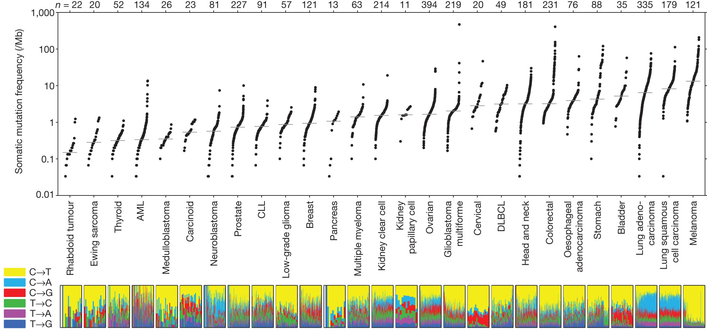
Figure 1: Somatic mutation frequencies observed in exomes from 3,083 tumour–normal pairs

Slide 20
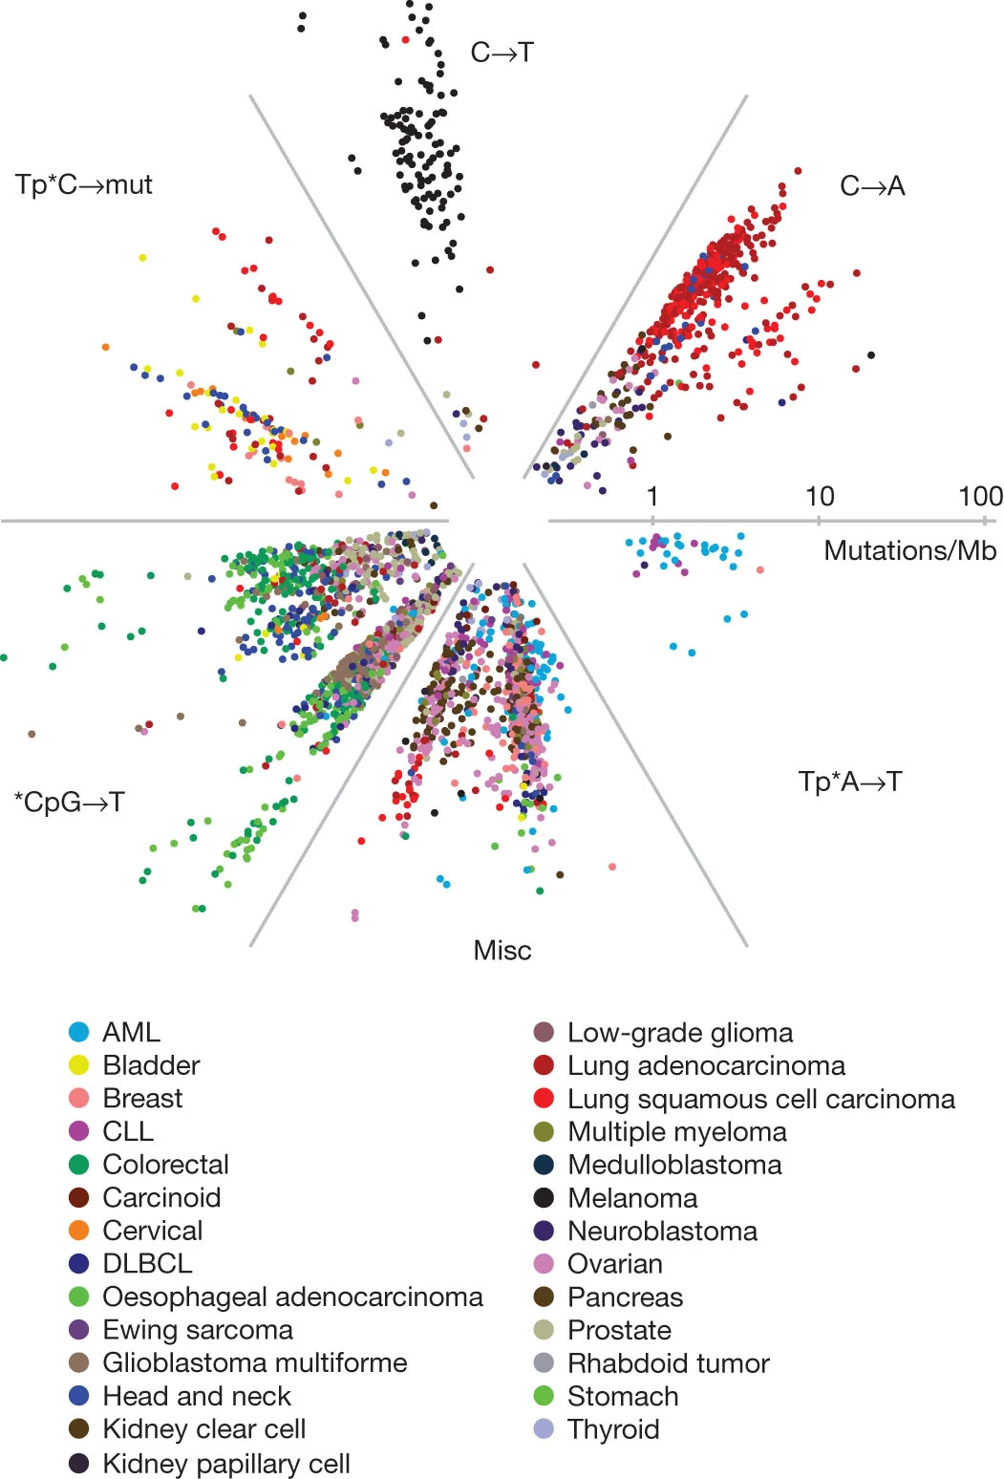
Figure 2: Radial spectrum plot of the 2,892 tumour samples with at least 10 coding mutations.

Slide 21
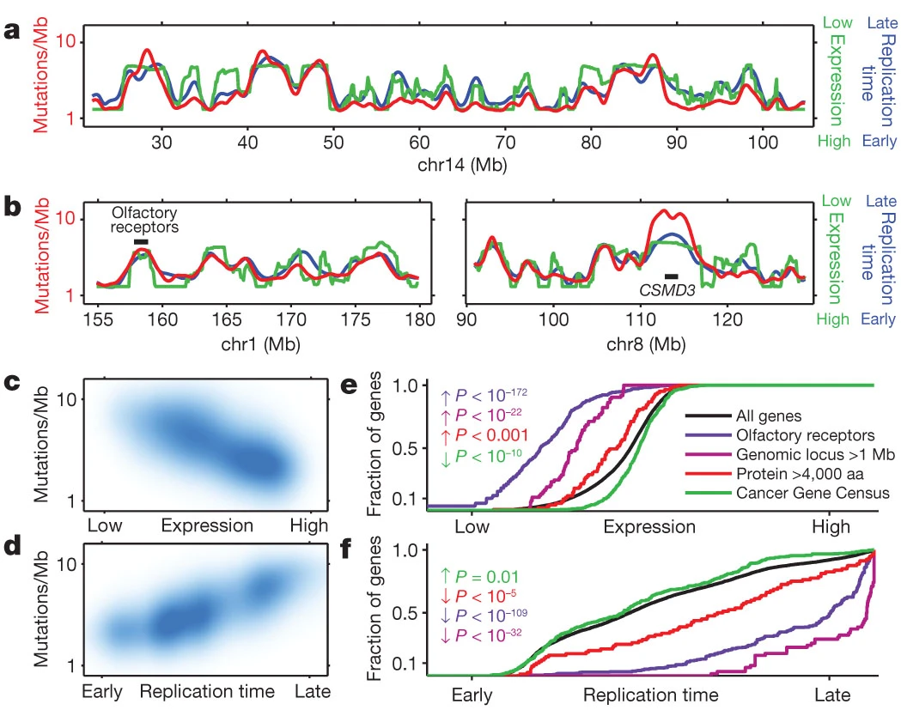
Figure 3: Mutation rate varies widely across the genome and correlates with DNA replication time and expression level.

Slide 22
Copy number alteration drivers

Slide 23
History for copy number variation study---detection of CNV in human genome
Detection of large-scale variation in the human genome
A John Iafrate,
Lars Feuk,
Miguel N Rivera,
Marc L Listewnik,
Patricia K Donahoe,
Ying Qi,
Stephen W Scherer &
Charles Lee
Nature Genetics volume 36, pages949–951 (2004)

Slide 24
We identified 255 loci across the human genome that contain genomic imbalances among unrelated individuals. Twenty-four variants are present in > 10% of the individuals that we examined. Half of these regions overlap with genes, and many coincide with segmental duplications or gaps in the human genome assembly. This previously unappreciated heterogeneity may underlie certain human phenotypic variation and susceptibility to disease and argues for a more dynamic human genome structure.

Slide 25
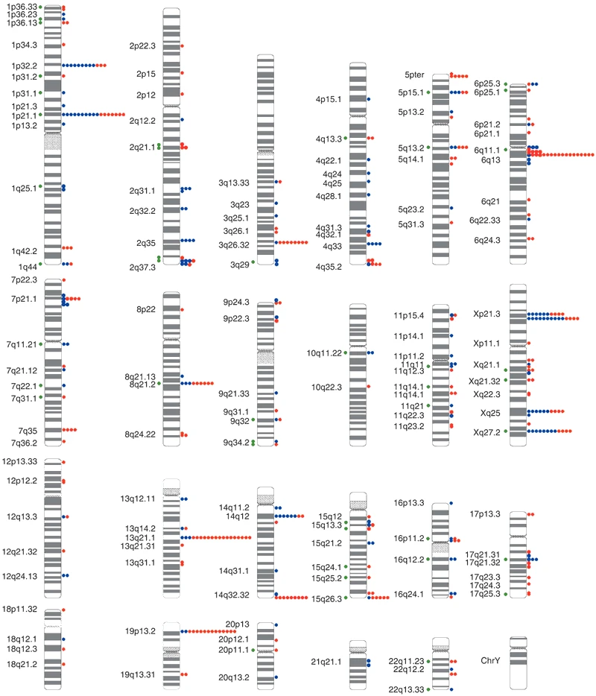
Figure 1: Distribution of LCVs in the human genome
large-scale copy-number variations (LCVs)

Slide 26
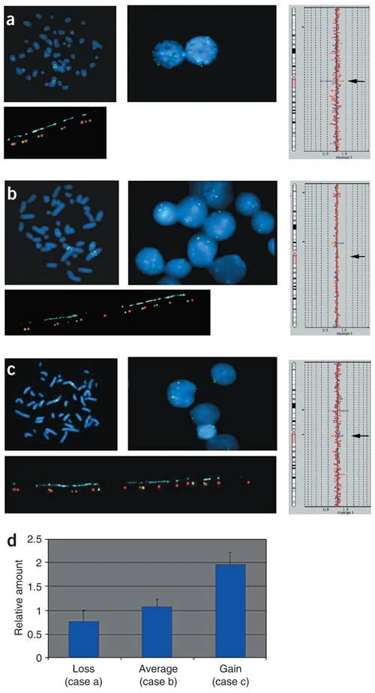
Figure 2: The most common polymorphism (BAC RP11-259N12) reflects differing numbers of tandem repeats in amylase genes
We described more than 200 LCVs in the human genome. Twenty-four of these variants are present in > 10% of the individuals that we studied, and six of these variants are present at a frequency of > 20%.

Slide 27
Science. 2004 Jul 23;305(5683):525-8. doi: 10.1126/science.1098918.
Large-scale copy number polymorphism in the human genome
Jonathan Sebat 1, B Lakshmi, Jennifer Troge, Joan Alexander, Janet Young, Pär Lundin, Susanne Månér, Hillary Massa, Megan Walker, Maoyen Chi, Nicholas Navin, Robert Lucito, John Healy, James Hicks, Kenny Ye, Andrew Reiner, T Conrad Gilliam, Barbara Trask, Nick Patterson, Anders Zetterberg, Michael Wigler

Slide 28
The extent to which large duplications and deletions contribute to human genetic variation and diversity is unknown. Here, we show that large-scale copy number polymorphisms (CNPs) (about 100 kilobases and greater) contribute substantially to genomic variation between normal humans. Representational oligonucleotide microarray analysis of 20 individuals revealed a total of 221 copy number differences representing 76 unique CNPs. On average, individuals differed by 11 CNPs, and the average length of a CNP interval was 465 kilobases. We observed copy number variation of 70 different genes within CNP intervals, including genes involved in neurological function, regulation of cell growth, regulation of metabolism, and several genes known to be associated with disease.

Slide 29
CNA calling method
Genome Res. 2007 Nov;17(11):1665-74. doi: 10.1101/gr.6861907. Epub 2007 Oct 5.
PennCNV: an integrated hidden Markov model designed for high-resolution copy number variation detection in whole-genome SNP genotyping data
Kai Wang 1, Mingyao Li, Dexter Hadley, Rui Liu, Joseph Glessner, Struan F A Grant, Hakon Hakonarson, Maja Bucan

Slide 30
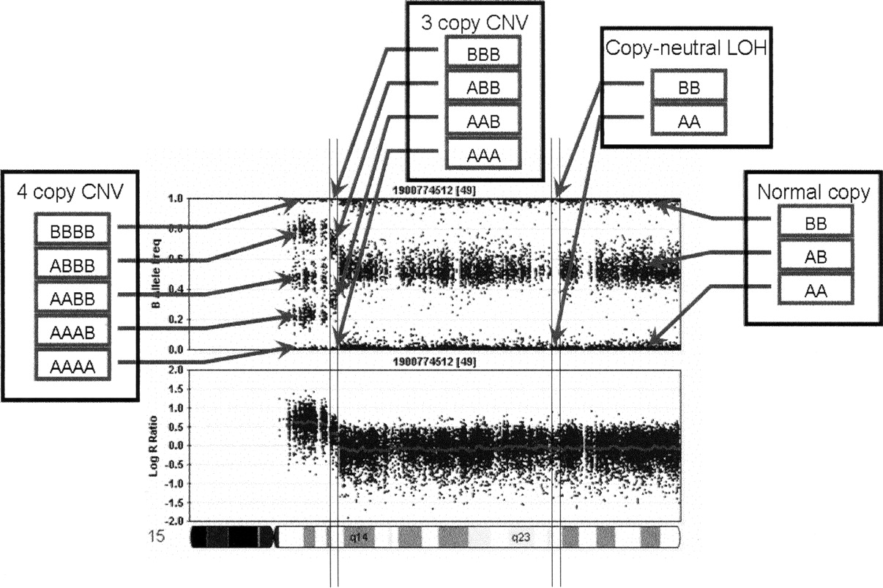
An illustration of log R Ratio (LRR) and B Allele Freq (BAF) values for the chromosome 15 q-arm of an individual.
A normal chromosome region has three BAF genotype clusters, as represented as AA, AB, and BB genotypes in boxes, and with LRR values centered around zero. The copy-neutral LOH region has normal LRR values, but without the AB genotype cluster. The increased copy number for a CNV region can be detected based on an increased number of peaks in the BAF distribution, as well as increased LRR values. The patterns of LRR and BAF for different CNV regions, normal regions, and copy-neutral LOH regions are distinct from each other, thus the combination of LRR and BAF can be used to generate CNV calls.

Slide 31
GISTIC method.
Beroukhim R, Getz G, Nghiemphu L, Barretina J, Hsueh T, Linhart D, Vivanco I, Lee JC, Huang JH, Alexander S, Du J, Kau T, Thomas RK, Shah K, Soto H, Perner S, Prensner J, Debiasi RM, Demichelis F, Hatton C, Rubin MA, Garraway LA, Nelson SF, Liau L, Mischel PS, Cloughesy TF, Meyerson M, Golub TA, Lander ES, Mellinghoff IK, et al:
Assessing the significance of chromosomal aberrations in cancer: methodology and application to glioma.
Proc Natl Acad Sci USA. 2007, 104: 20007–20012. 10.1073/pnas.0710052104.

Slide 32
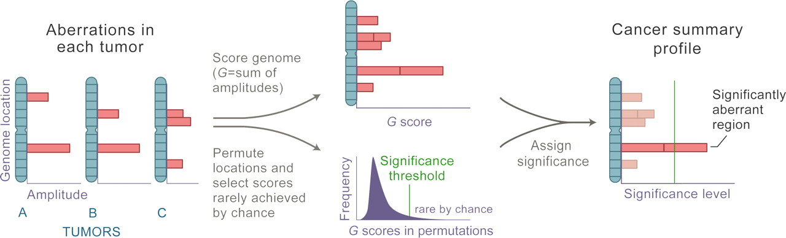
Overview of the GISTIC method.
Rameen Beroukhim et al. PNAS 2007;104:50:20007-20012

Slide 33
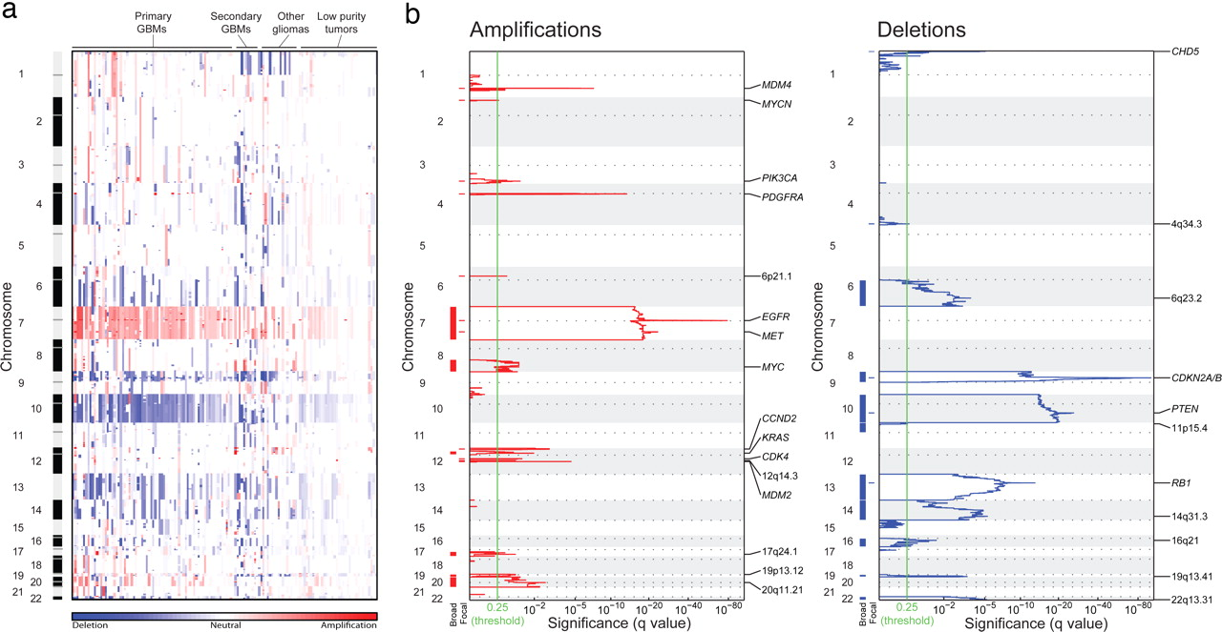
Significant broad and focal copy-number alterations in the glioma genome.

Slide 34
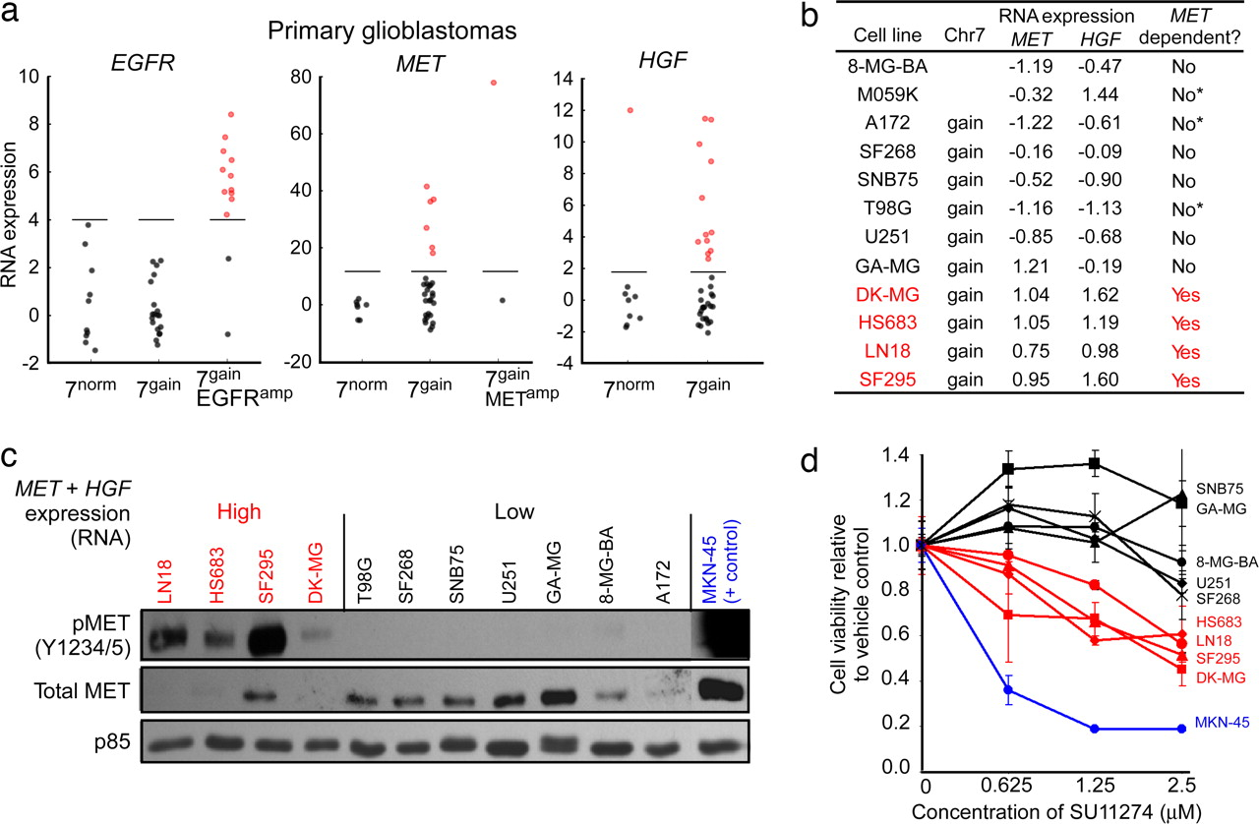
Broad gains of chromosome 7 often activate the MET pathway but not EGFR

Slide 36
Nature. 2010 Feb 18;463(7283):899-905. doi: 10.1038/nature08822.
The landscape of somatic copy-number alteration across human cancers

Slide 37
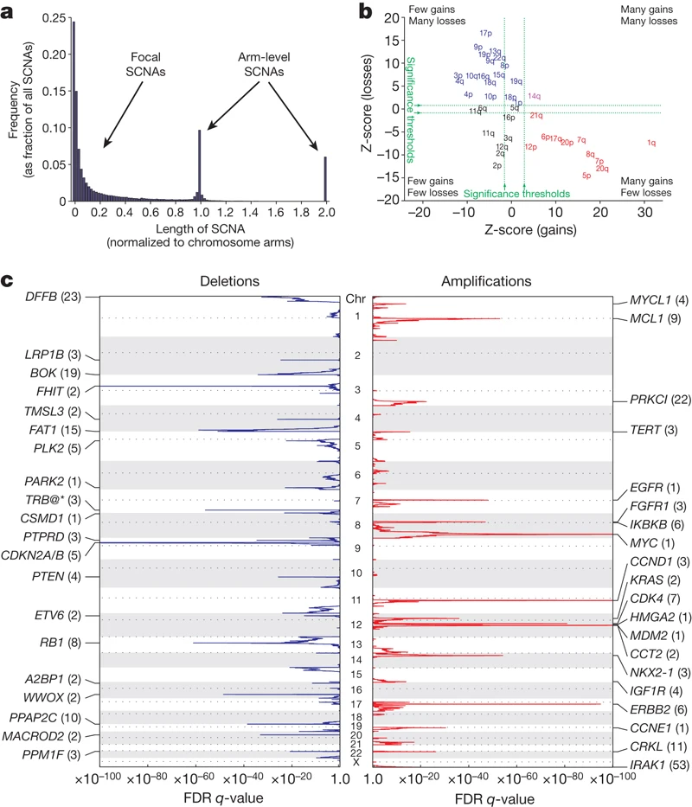
Figure 1: Identification of significant arm-level and focal SCNAs across cancer

Slide 38
A compendium of mutational cancer driver genes
Francisco Martínez-Jiménez,
…
Nuria Lopez-Bigas
Nature Reviews Cancer volume 20, pages555–572 (2020)Cite this article

Slide 39
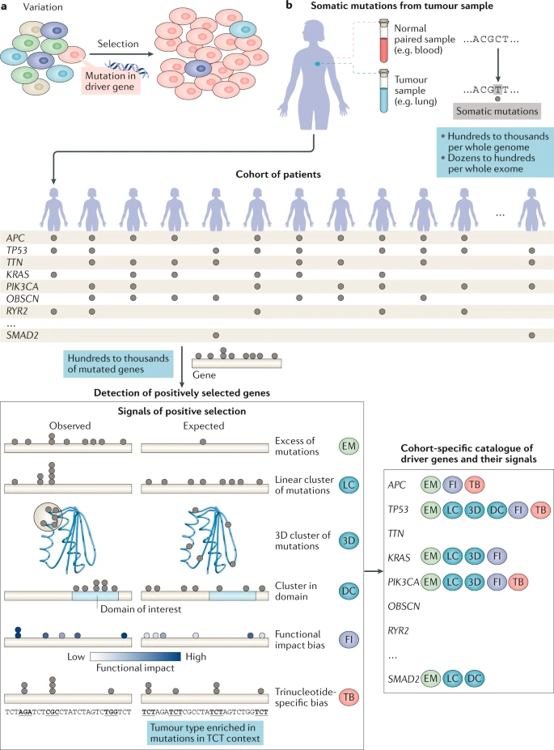
Fig. 1: Signals of positive selection identify driver genes

Slide 40
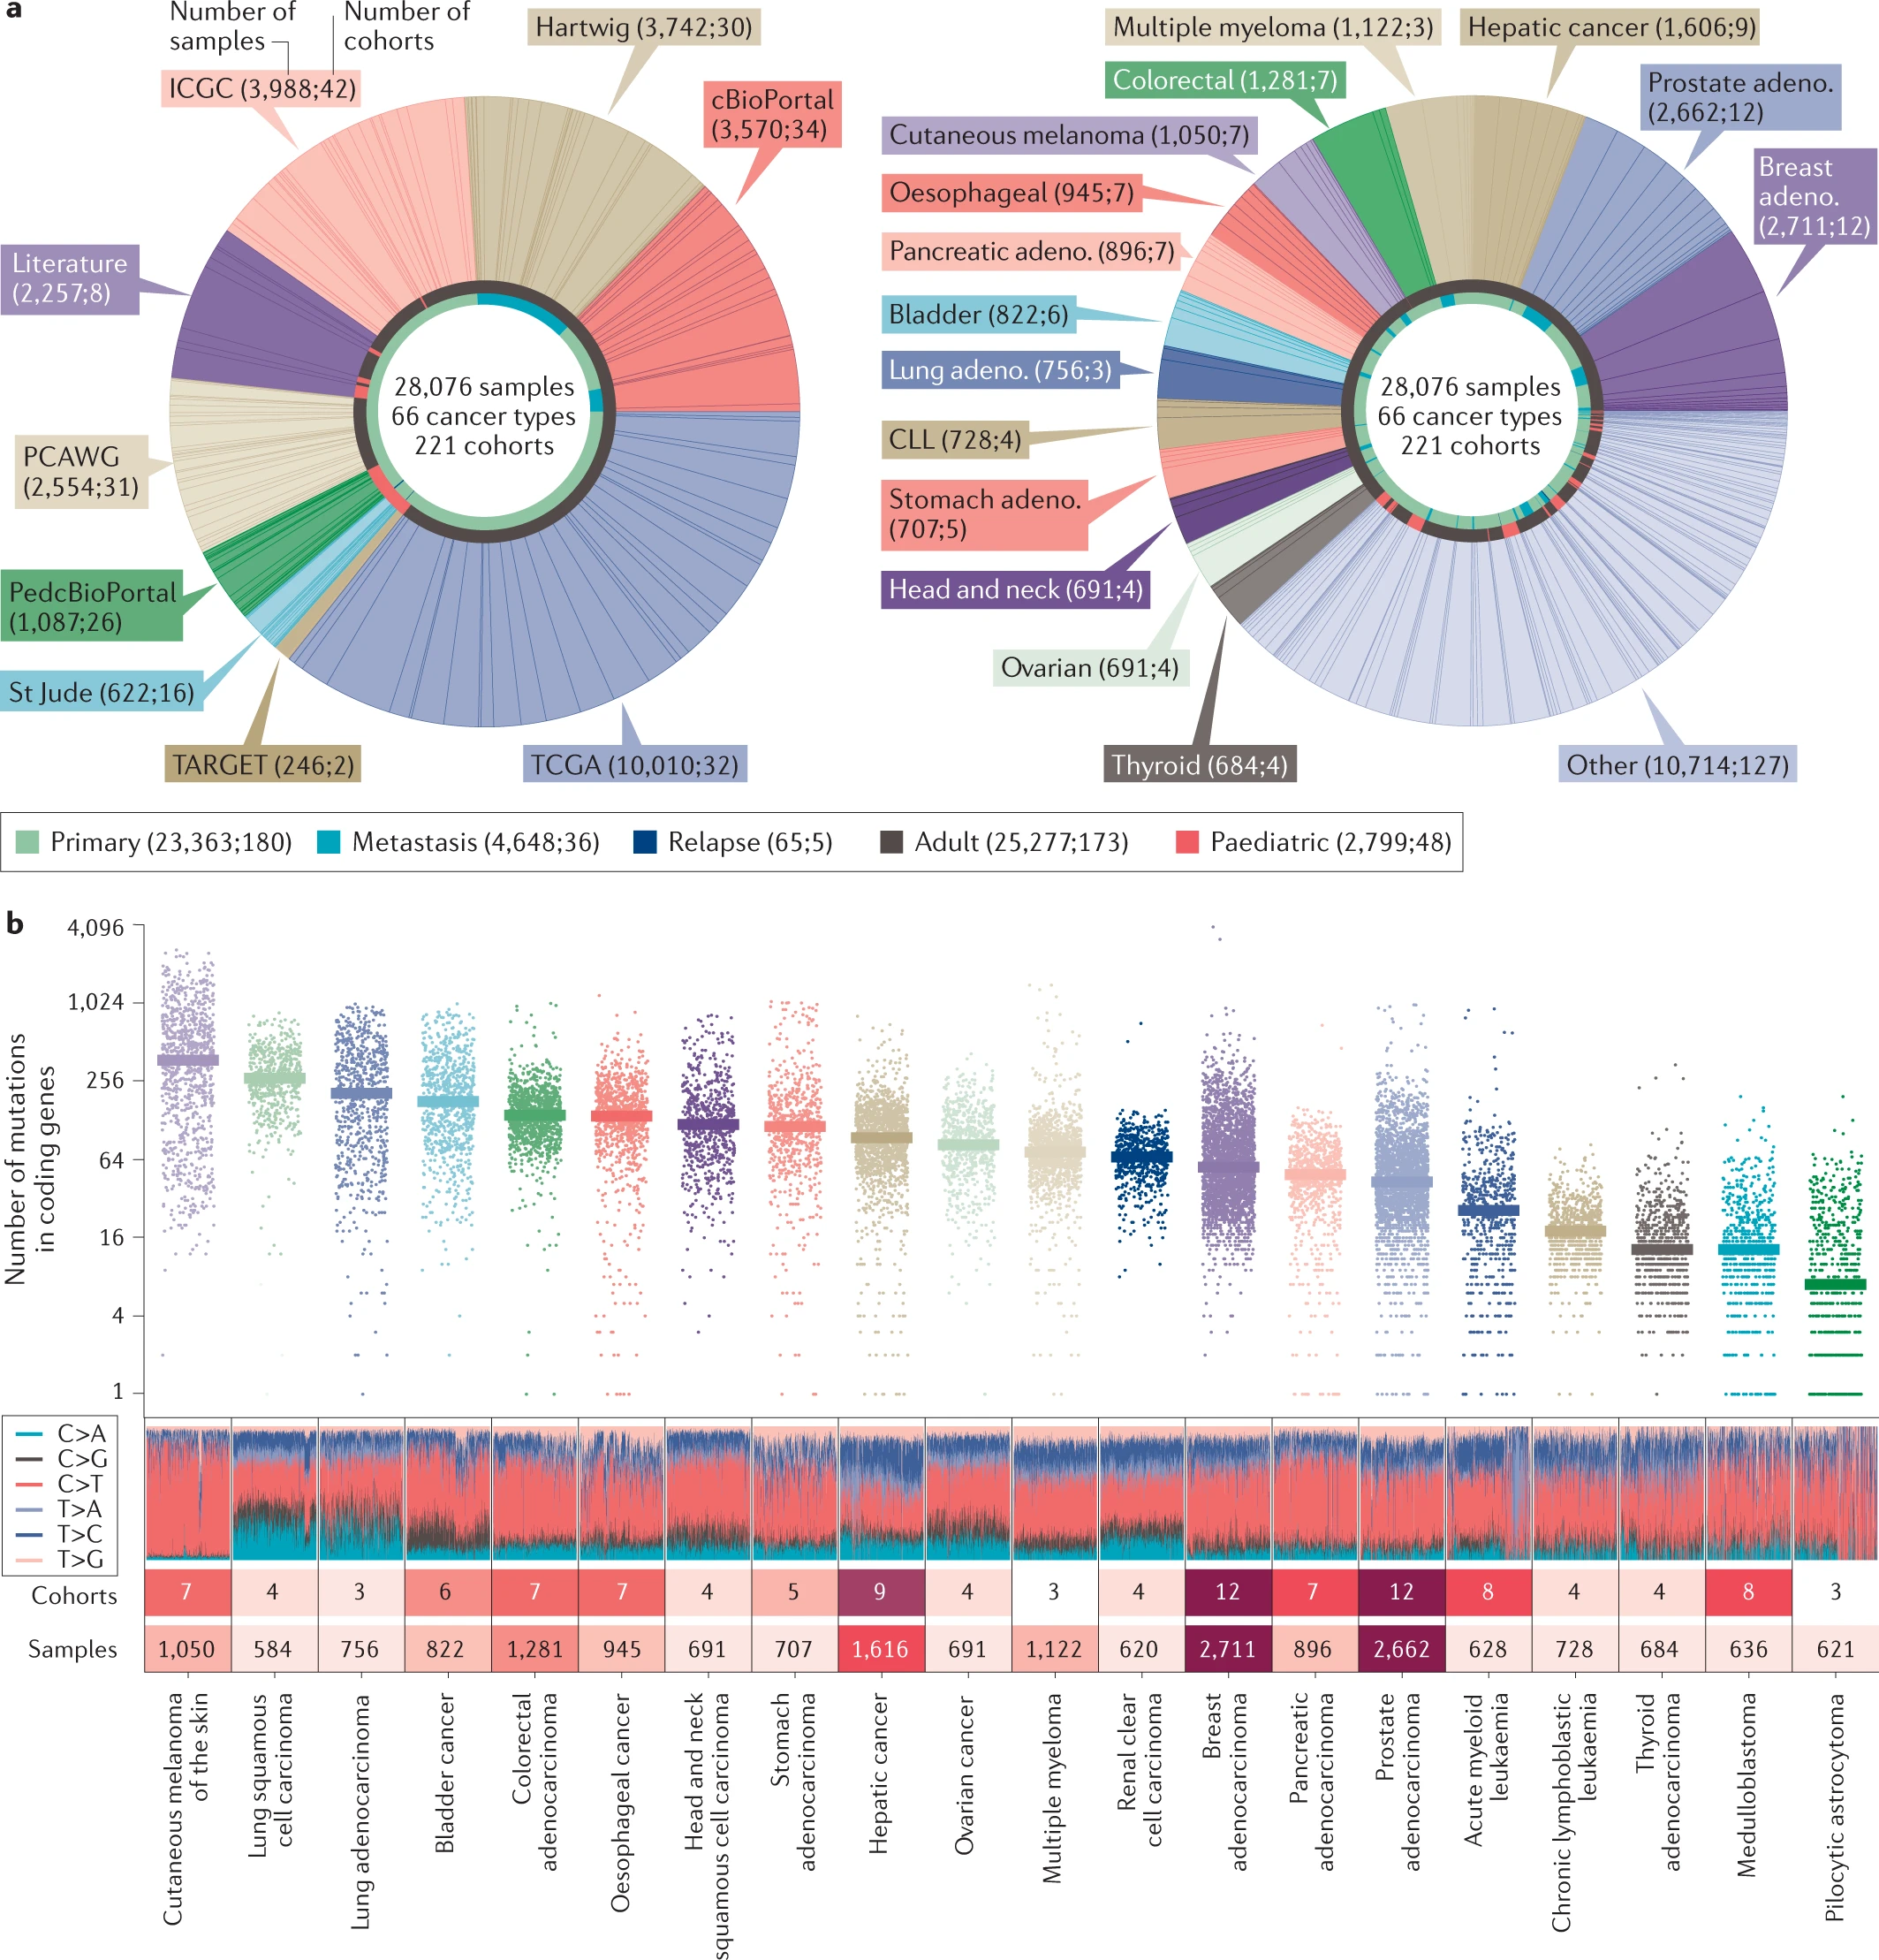
Fig. 2: Application of the IntOGen pipeline to datasets of tumour mutations

Slide 41
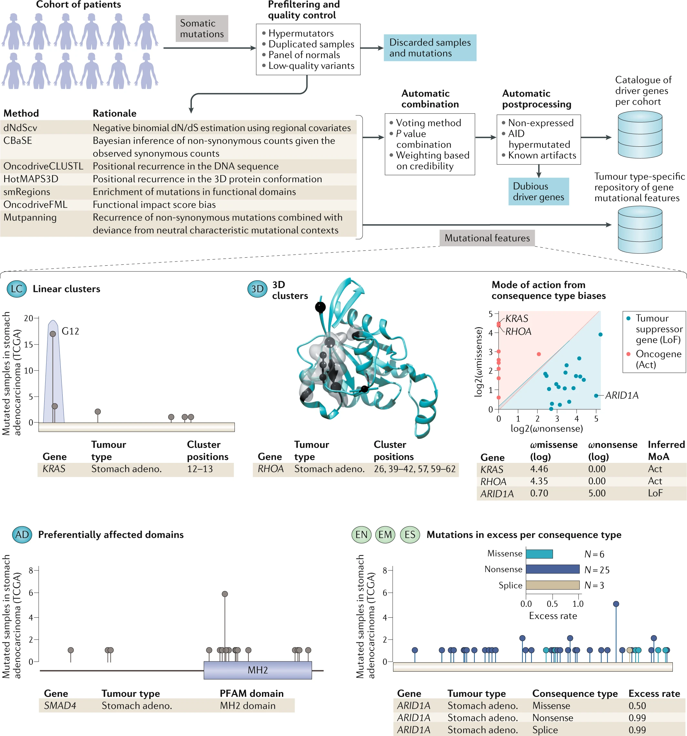
Fig. 3: Schematic representation of the Integrative OncoGenomics (IntOGen) pipeline

Slide 42
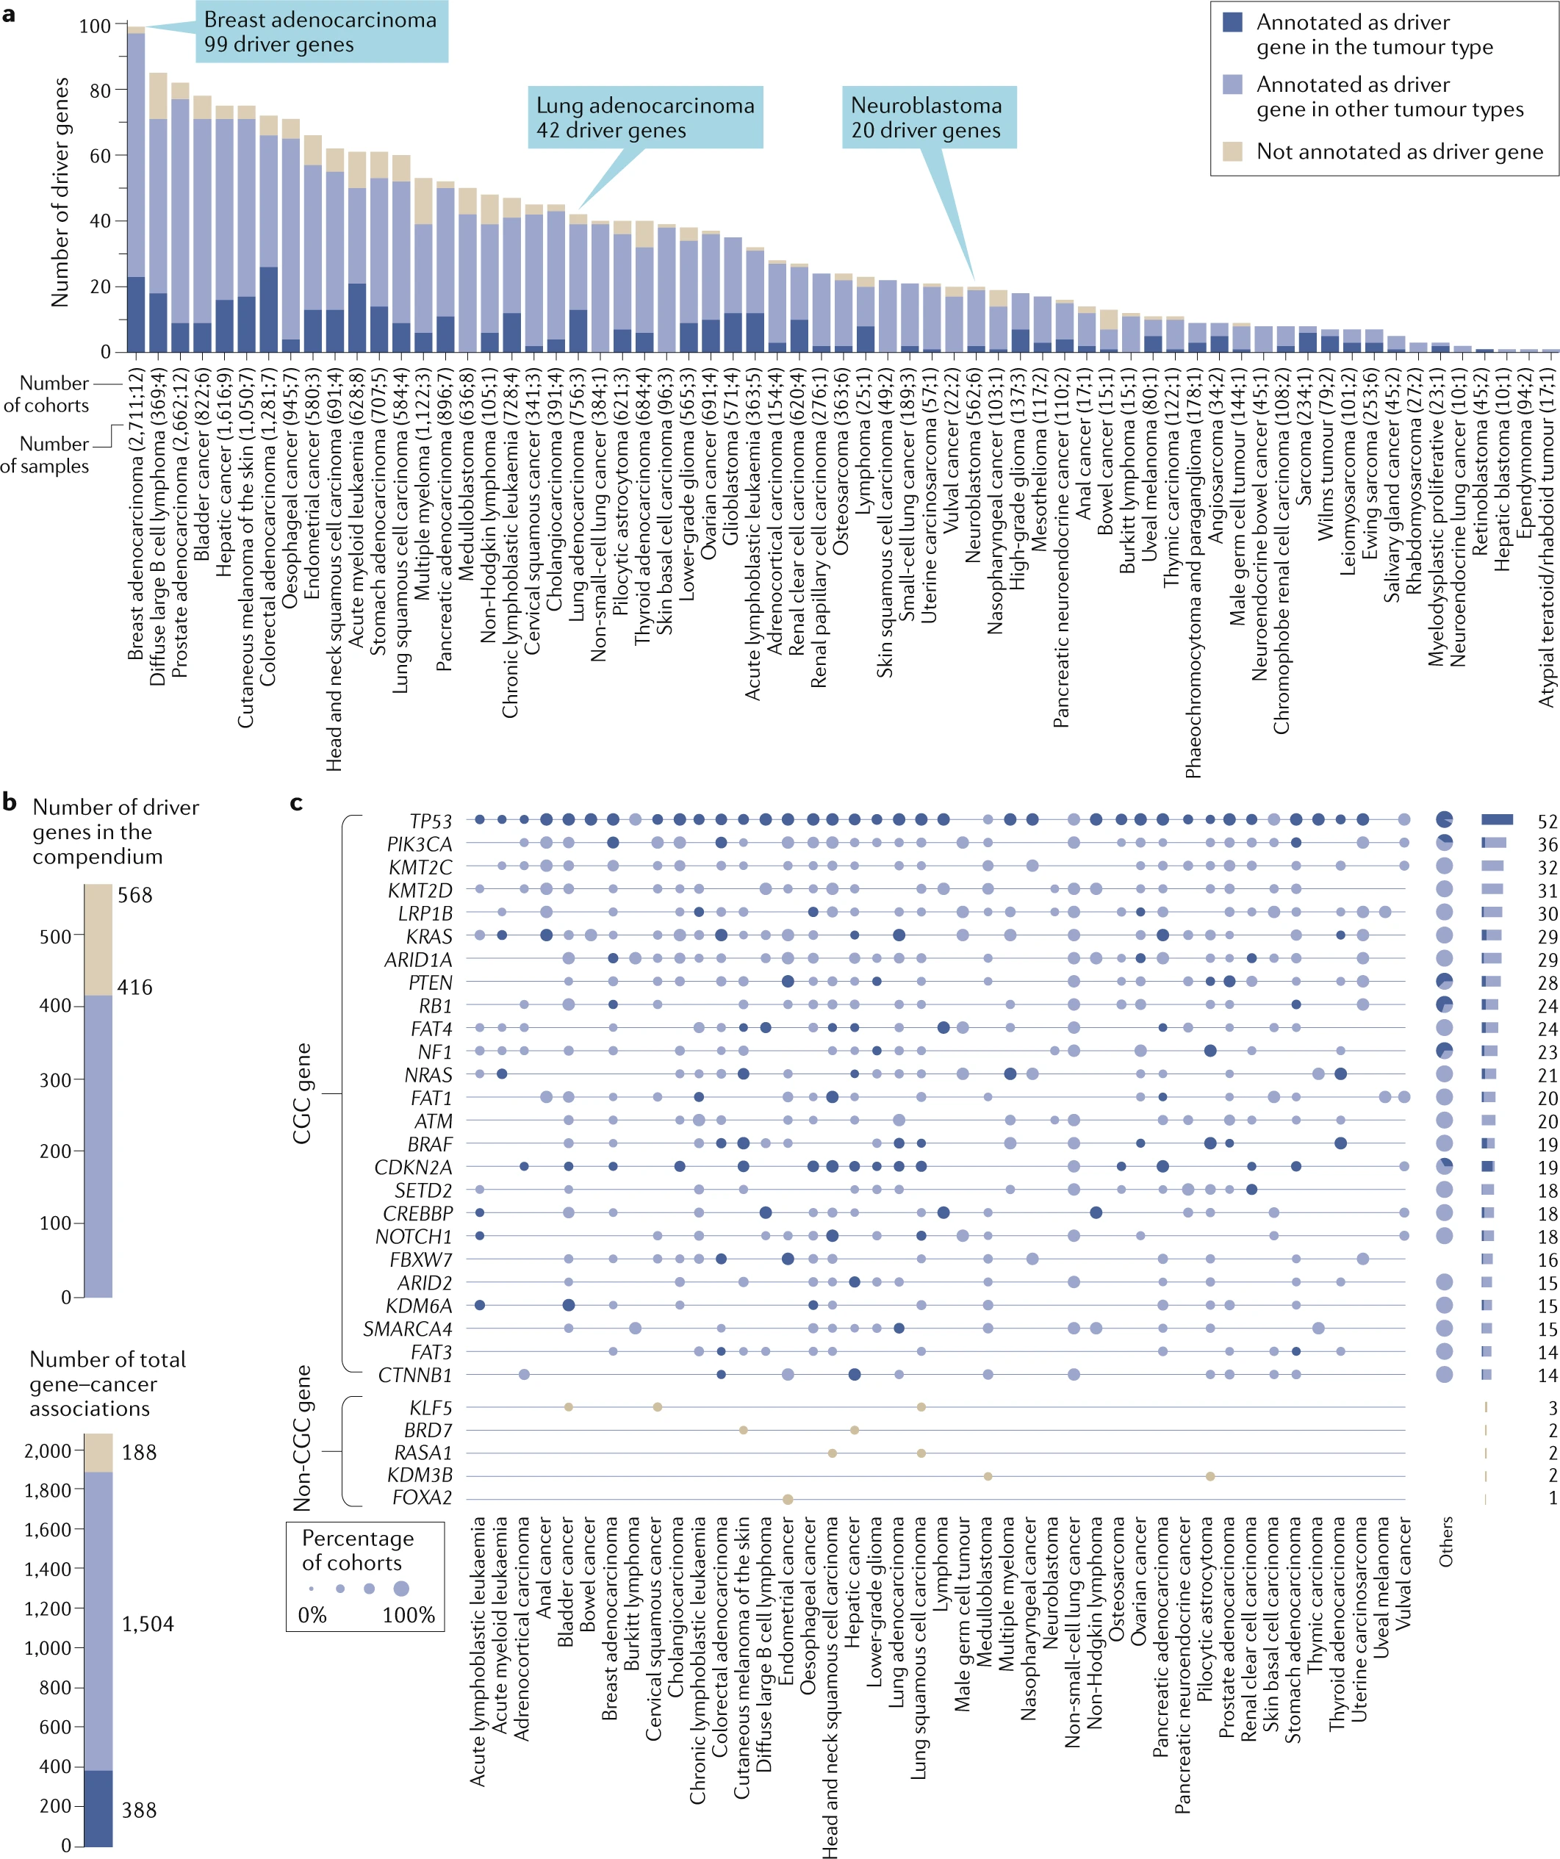
Fig. 4: A snapshot of the compendium of mutational driver genes
Cancer Gene Census (CGC)

Slide 43
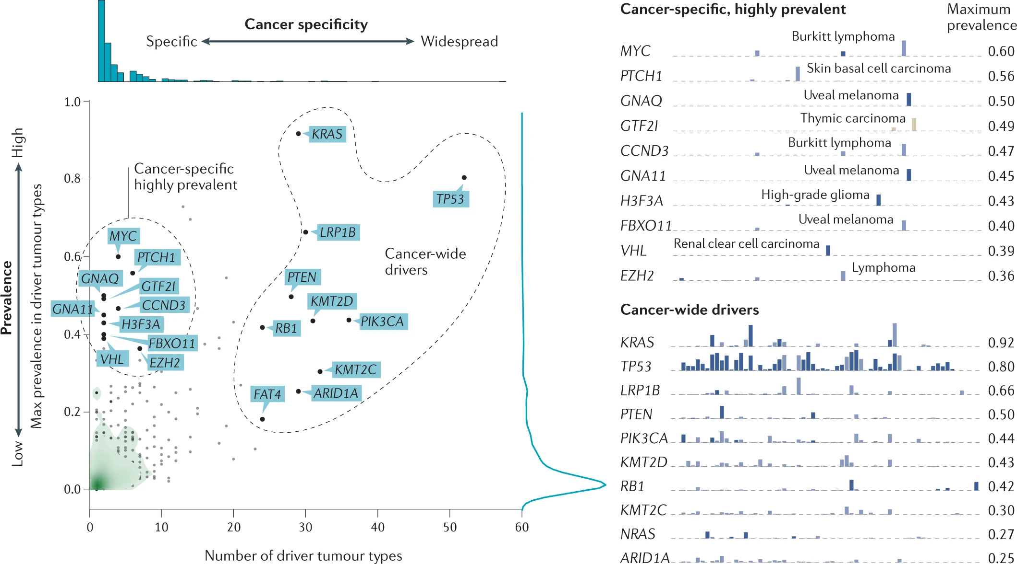
Fig. 5: Distribution of the prevalence of driver genes across cancer types in the compendium

Slide 44
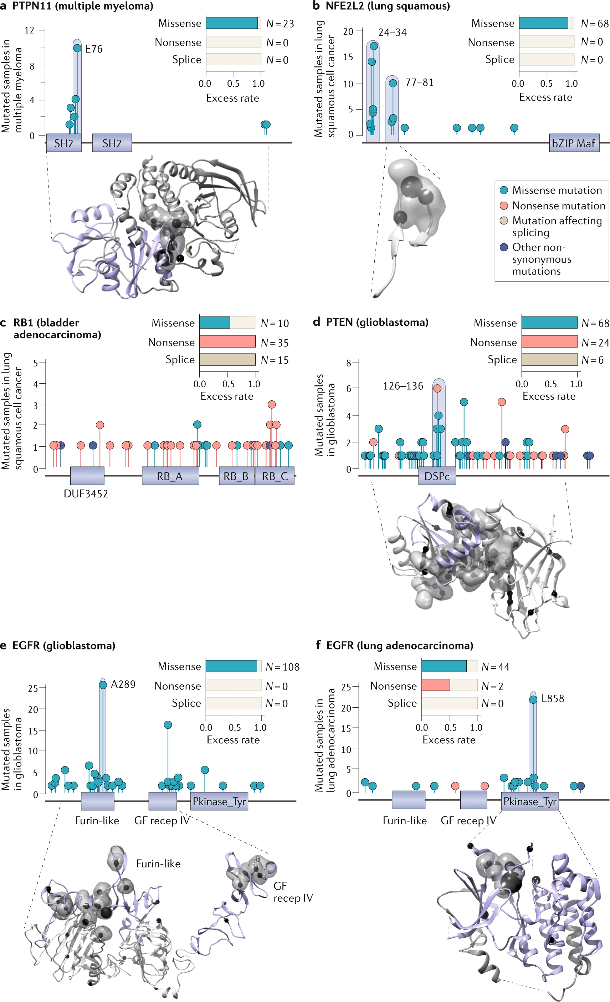
Fig. 6: Interpreting the mutational patterns of driver genes

Slide 45
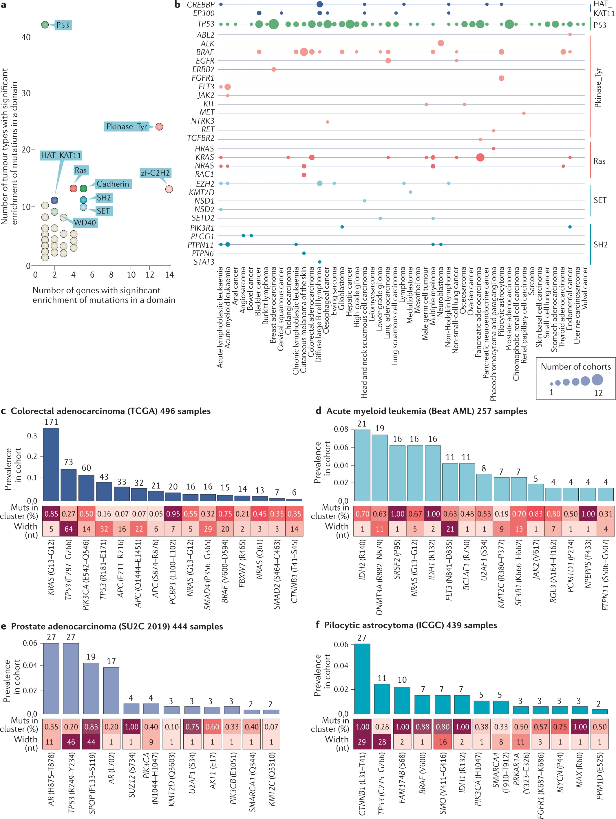
Fig. 7: Recurrent cancer driver domains and mutational clusters

Slide 46
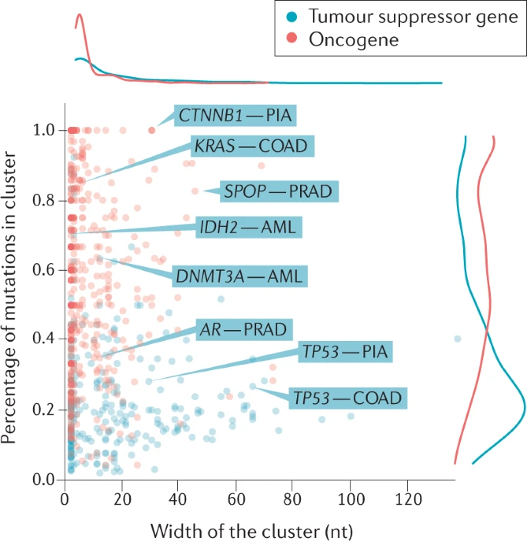
Fig. 8: Linear clusters detected in tumour suppressors and oncogenes in the compendium

Slide 47
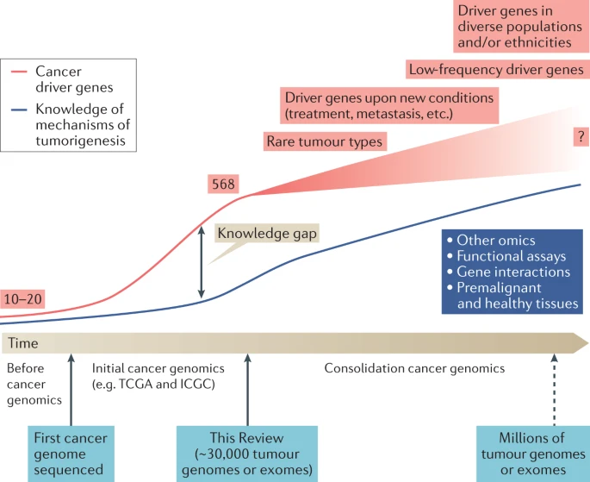
Fig. 9: The past, present and future of cancer genomics

Slide 48
DNA mutational process and mutational signature

Slide 49
DNA mutational process and mutational signature
ageing
DNA repair defects
APOBEC
smoking

Slide 50
Mutational signature analysis
1，Signature extraction methods
Mutational signature methods
Copy number signature method
2，Signatures in cancer precision medicine
HRD prediction
APOBEC signature and immunotherapy
CNA burden and cancer prognosis
CNA signature and cancer prognosis
Passenger mutation pattern and cancer classification
Signature and cancer targeted therapy----metabolism perspective

Slide 51
Nik-Zainal, S. et al.
Mutational processes molding the genomes of 21 breast cancers.
Cell 149, 979–993 (2012)

Slide 52
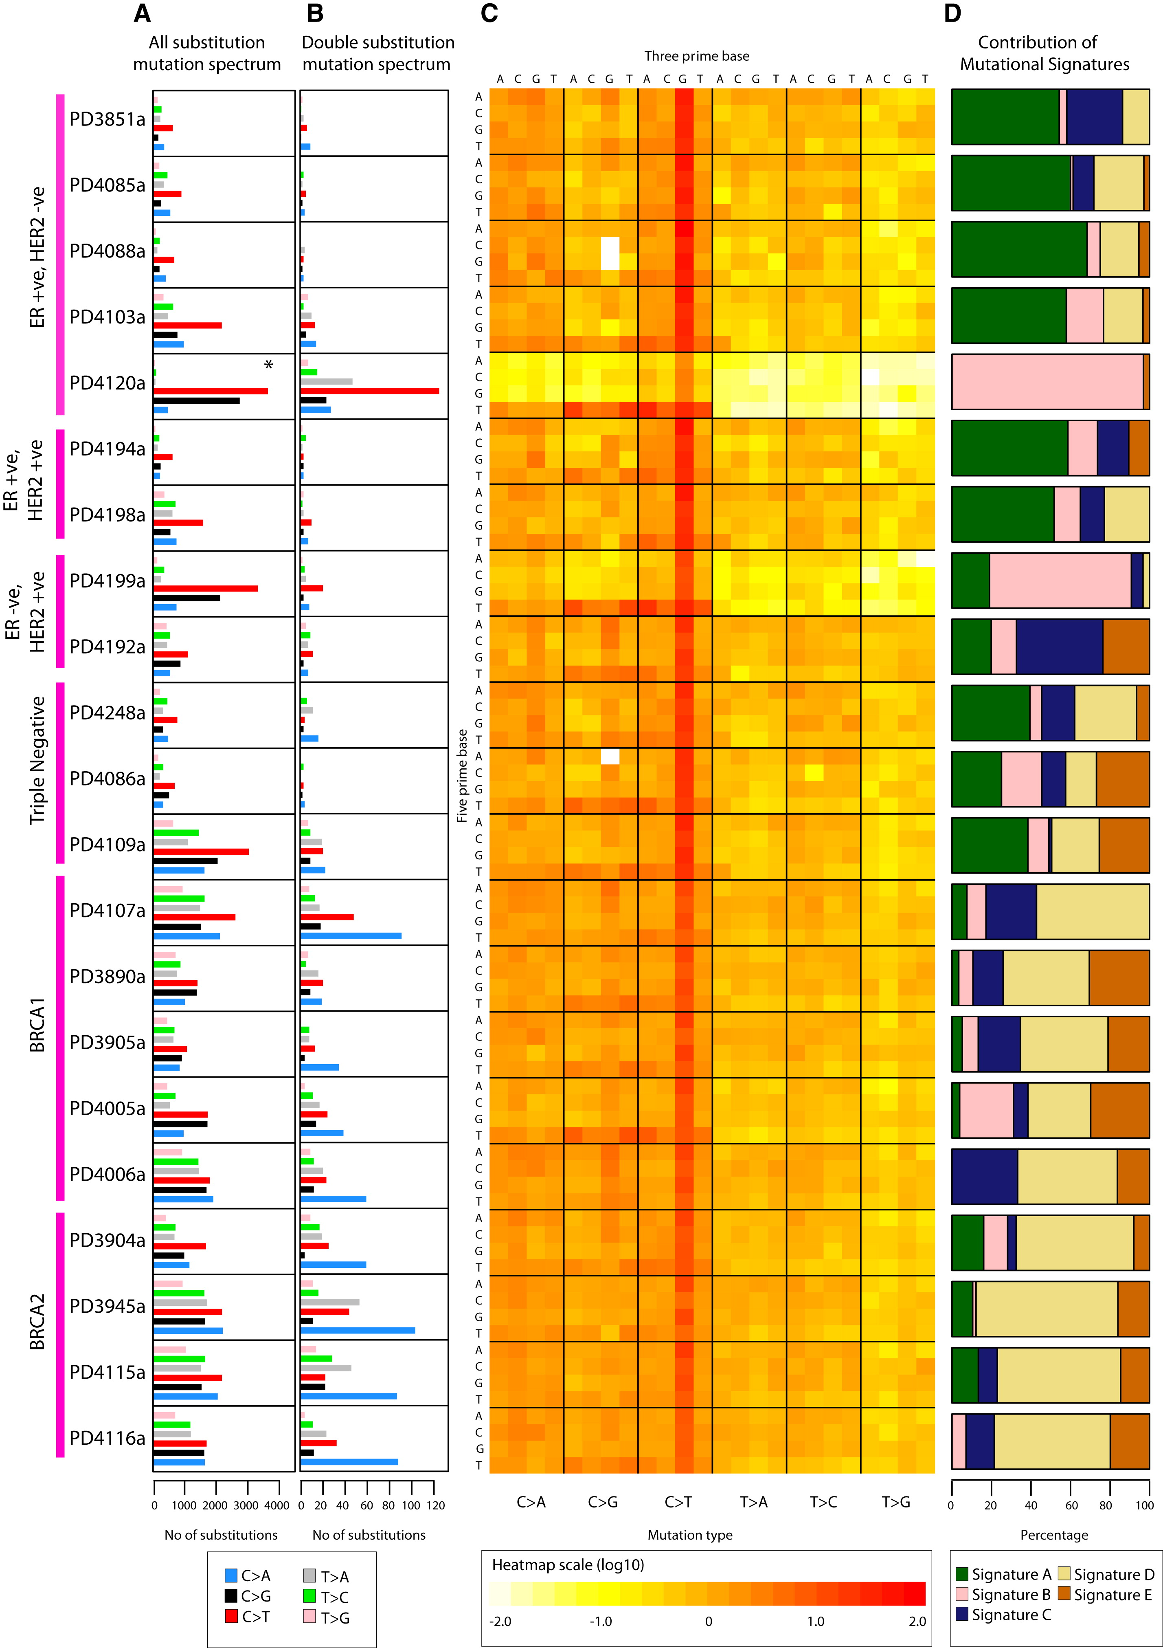
Figure 1. Somatic Mutation Profiles of 21 Breast Cancers

Slide 53
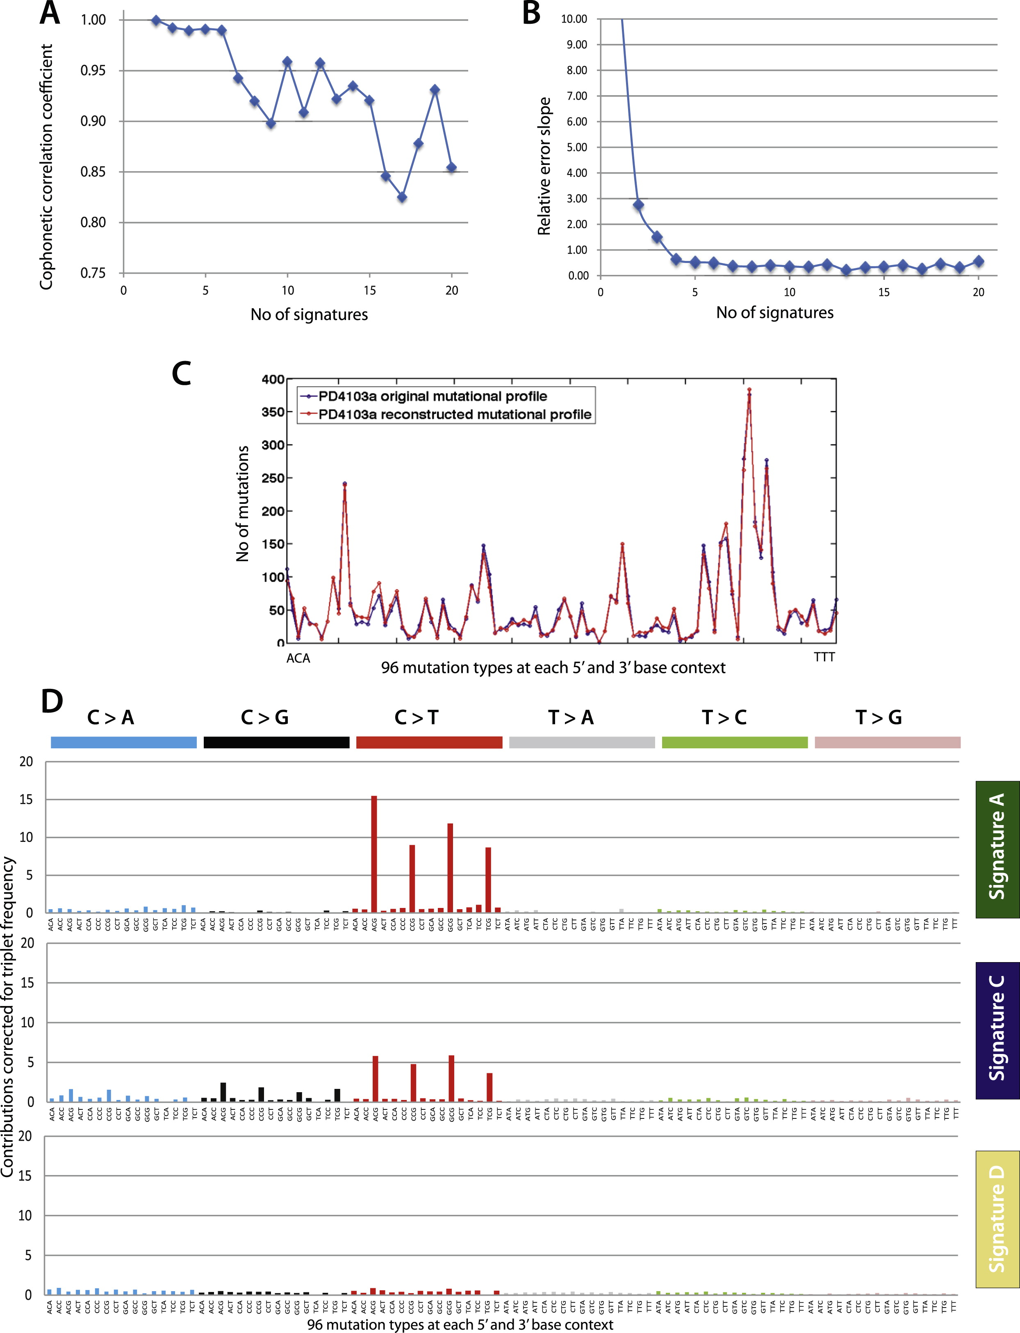
Figure S1. Selection of the Optimal Number of Signatures via the NMF Model Selection Framework

Slide 54
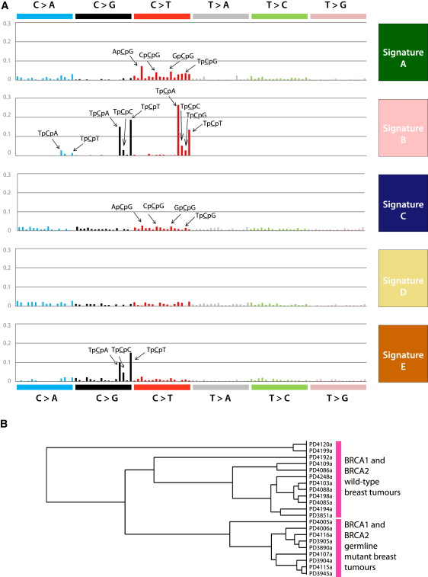
Figure 2. Five Mutational Signatures Extracted by NMF in 21 Breast Cancers

Slide 55
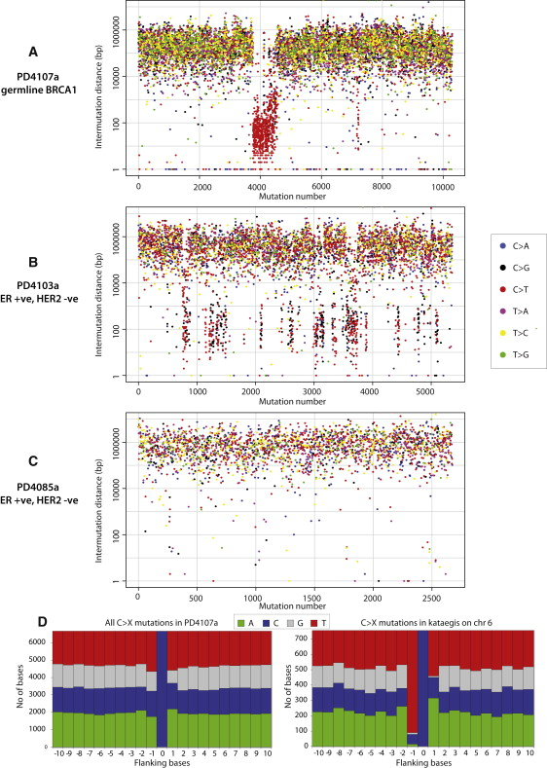
Figure 3. Kataegis, Regional Hypermutation of Base Substitutions

Slide 56
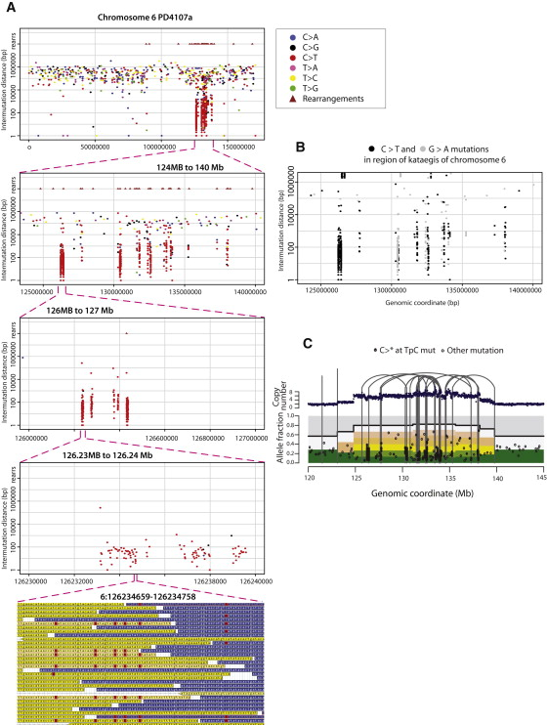
Figure 4. Rainfall Plot for Chromosome 6 of PD4107a

Slide 57
Alexandrov, L. B., Nik-Zainal, S., Wedge, D. C., Campbell, P. J. & Stratton, M. R.
Deciphering signatures of mutational processes operative in human cancer.
Cell Rep. 3, 246–259 (2013)

Slide 58
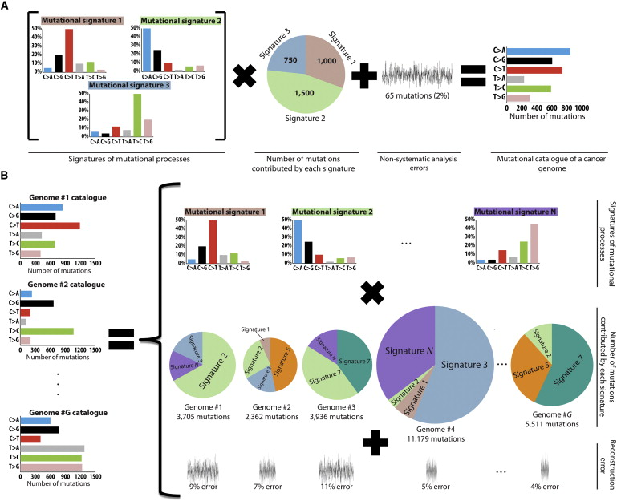
Figure 1. Modeling Signatures of Mutational Processes Operative in Cancer Genomes

Slide 59
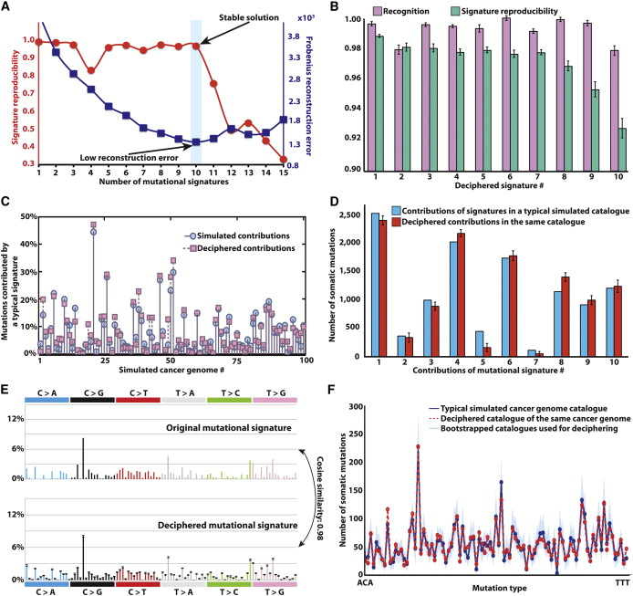
Figure 2. Deciphering Signatures of Mutational Processes from a Set of Simulated Mutational Catalogs from 100 Cancer Genomes

Slide 60
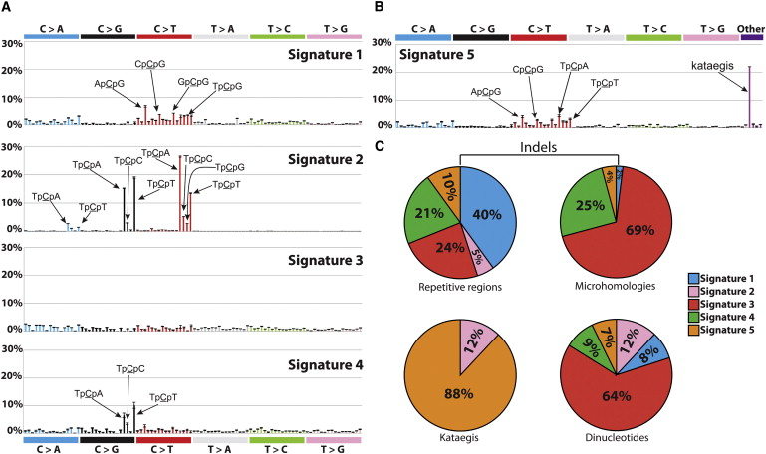
Figure 4. Signatures of Mutational Processes Extracted from the Mutational Catalogs of 21 Breast Cancer Genomes

Slide 61
Signatures of mutational processes in human cancer
Ludmil B. Alexandrov,
Serena Nik-Zainal,
[…]
Michael R. Stratton
Nature volume 500, pages415–421 (2013)Cite this article

Slide 62
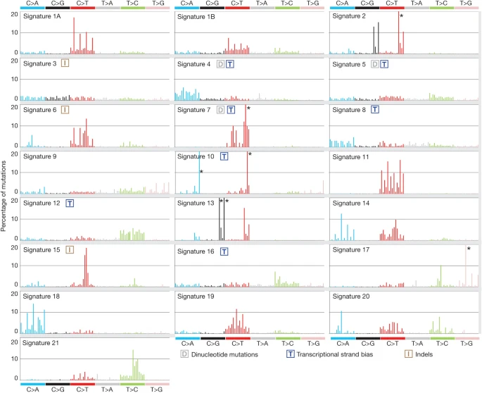
Figure 2: Validated mutational signatures found in human cancer

Slide 63
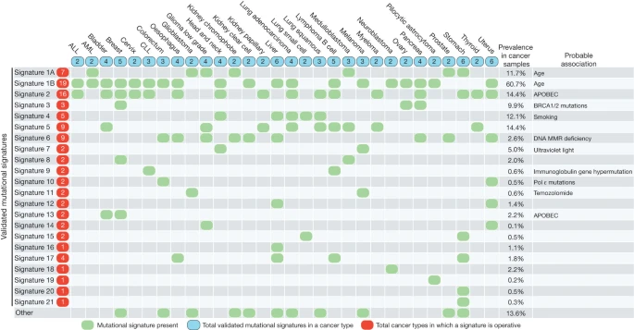
Figure 3: The presence of mutational signatures across human cancer types

Slide 64
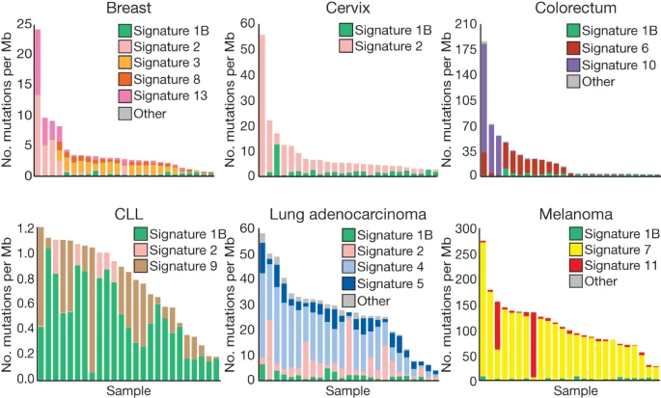
Figure 4: The contributions of mutational signatures to individual cancers of selected cancer types

Slide 65
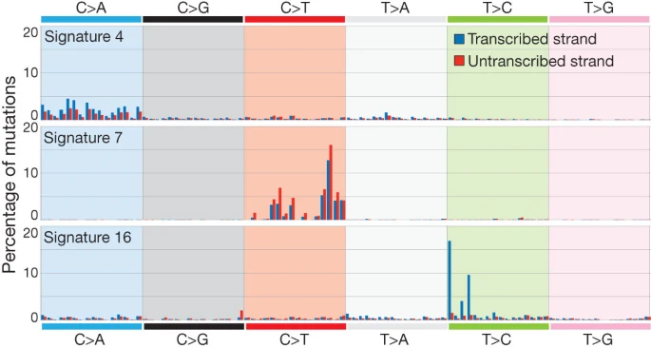
Figure 5: Selected mutational signatures with strong transcriptional strand bias

Slide 66
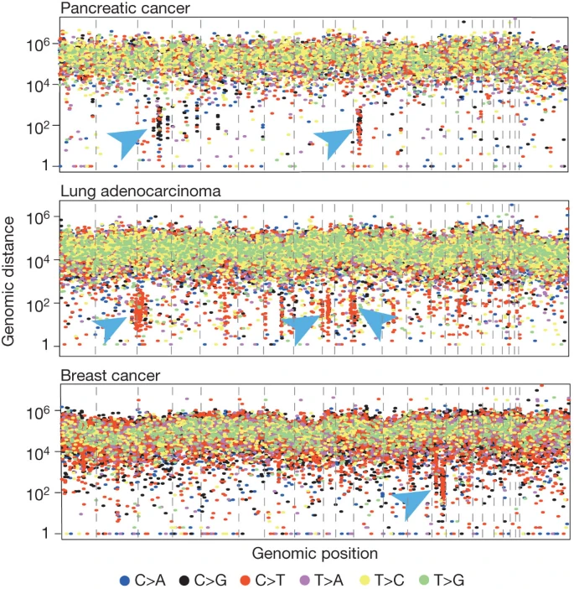
Figure 6: Kataegis in three cancers

Slide 67
Signatures and Mutational Processes for Copy Number Alteration

Slide 68
Patterns and mechanisms of structural variations in human cancer
Kijong Yi &
Young Seok Ju
Experimental & Molecular Medicine volume 50, pages1–11 (2018)Cite this article

Slide 69
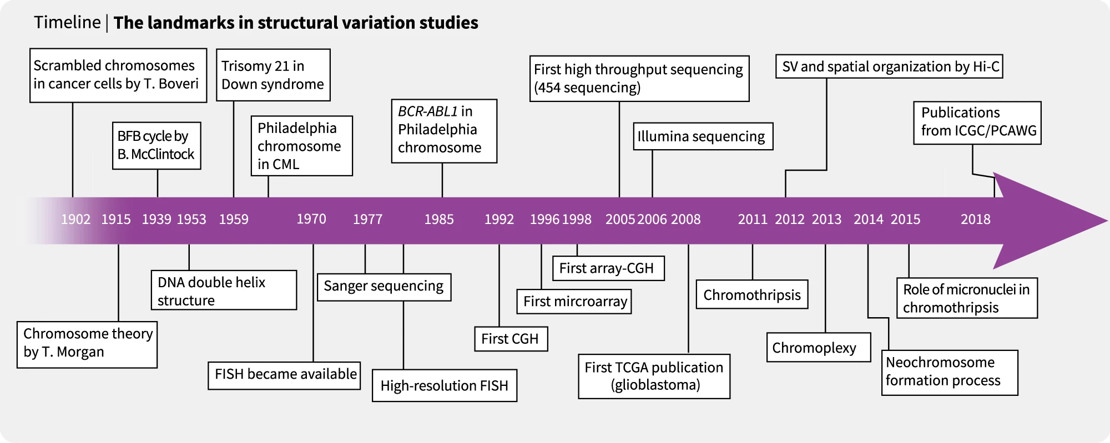
Fig.1 The history of structural variation research

Slide 70
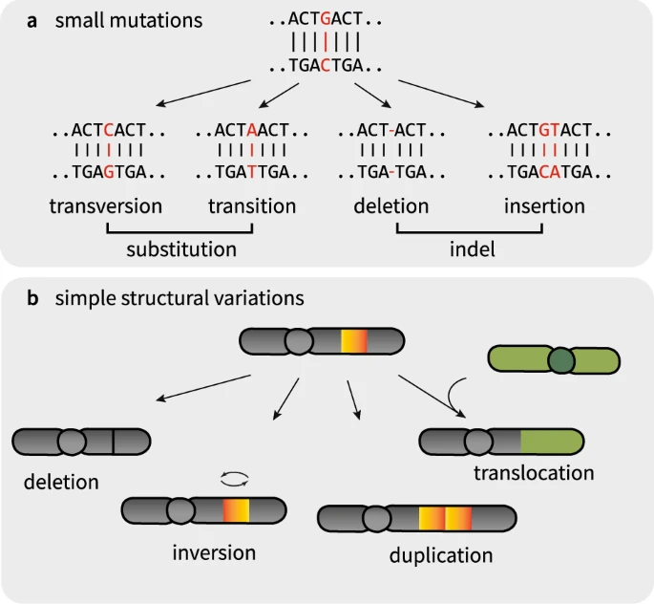
Fig. 2: Types of basic genomic variations

Slide 71
Fig. 3: Patterns and proposed mechanisms of structural variations

Slide 72
Fig. 3: Patterns and proposed mechanisms of structural variations

Slide 73
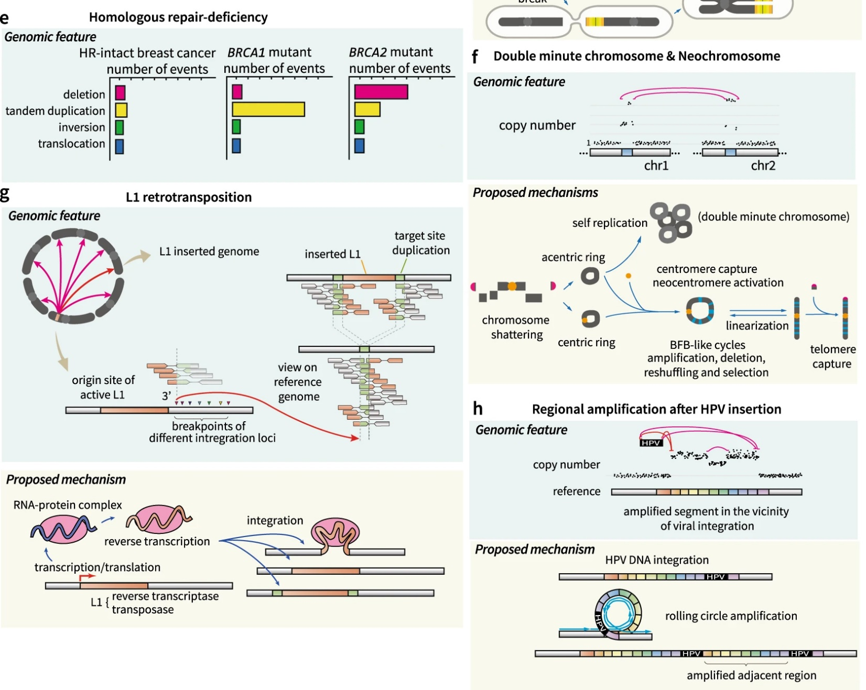
Fig. 3: Patterns and proposed mechanisms of structural variations

Slide 74
Patterns of somatic structural variation in human cancer genomes
Yilong Li,
……
Peter J. Campbell &
PCAWG Consortium
Nature volume 578, pages112–121 (2020)Cite this article

Slide 75
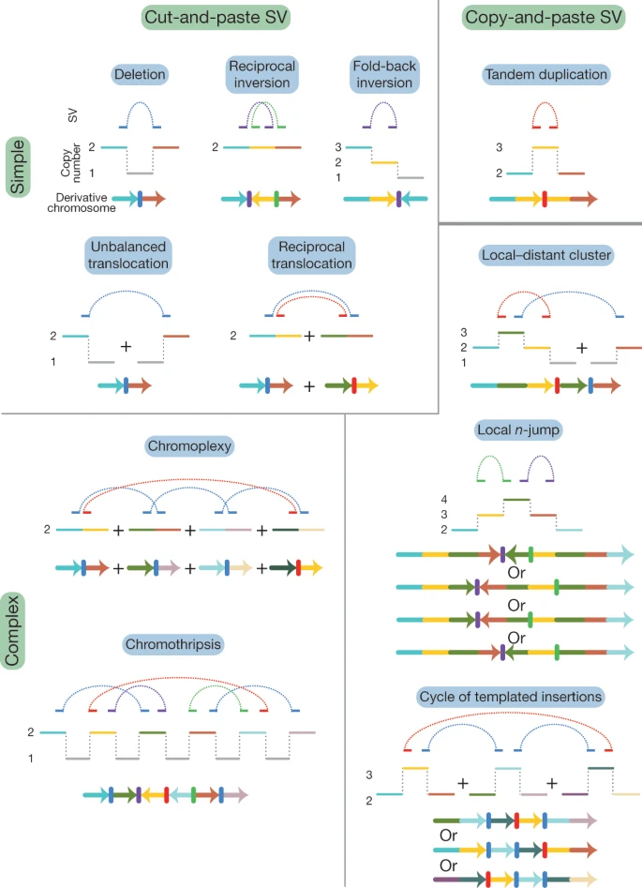
Fig. 1: Classification of structural variants in cancer genomes

Slide 76
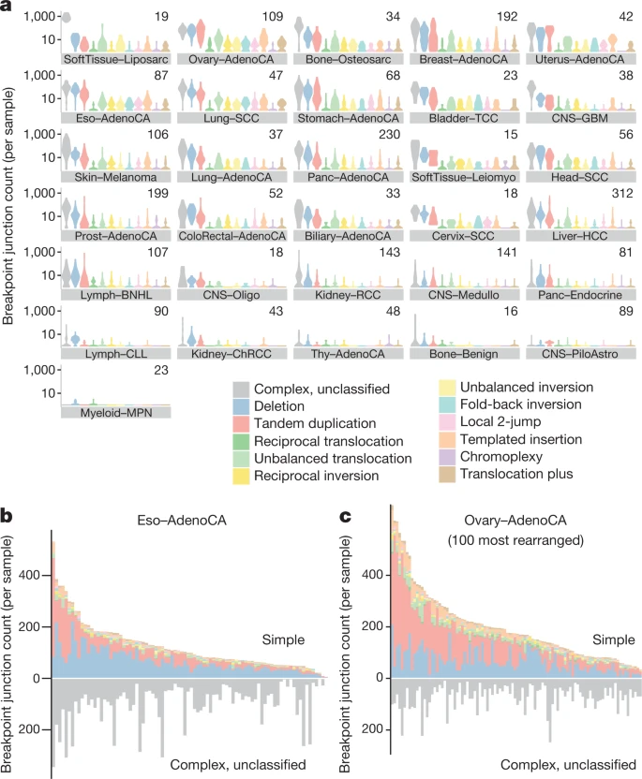
Fig. 2: Frequency of structural-variant classes across tumour types

Slide 77
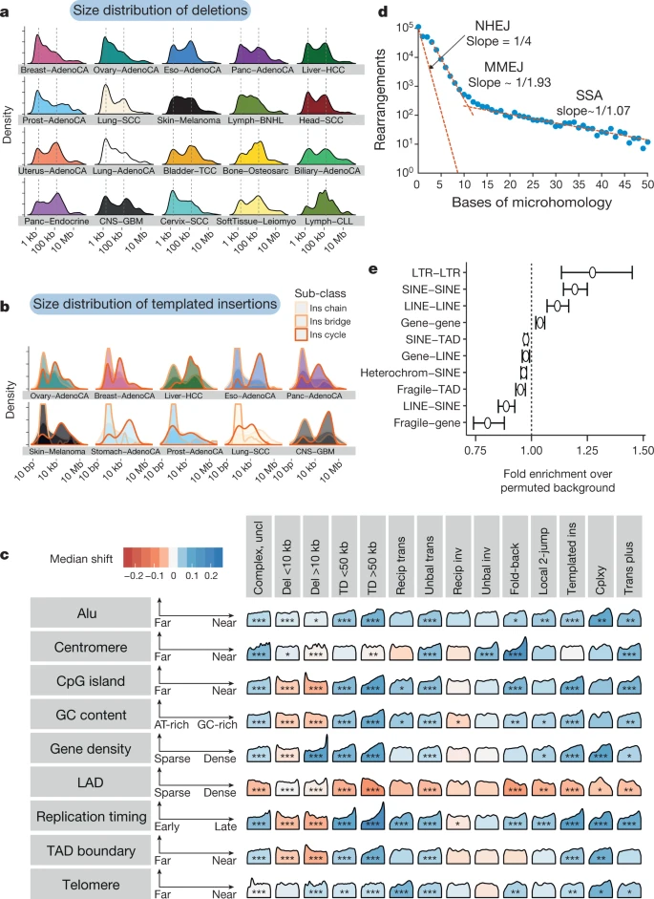
Fig. 5: Size distribution and genomic properties of classified structural variants

Slide 78
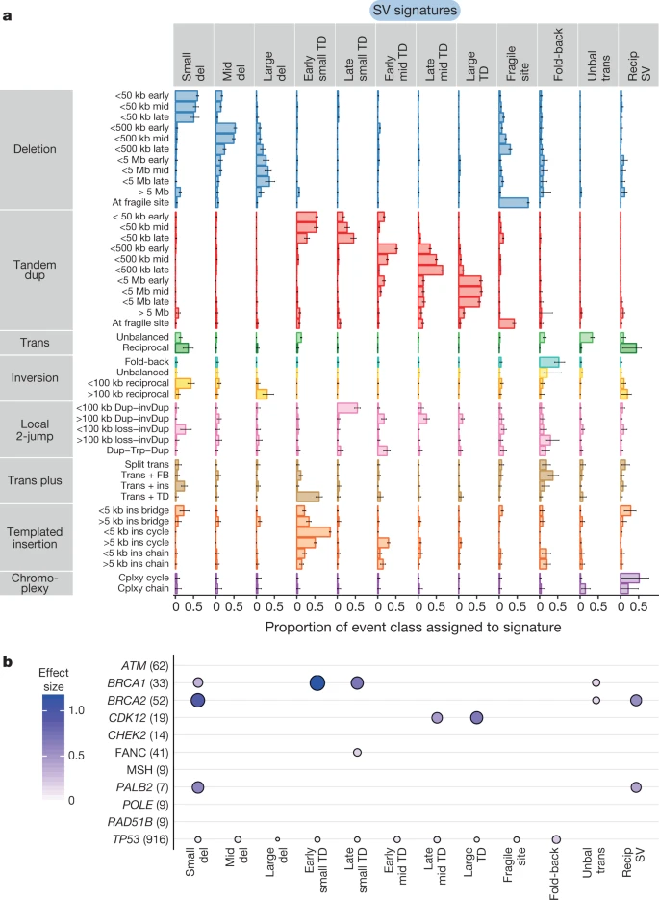
Fig. 6: Structural-variant signatures in human cancers

Slide 79
Applications for cancer mutational signature analysis
HRD prediction
APOBEC signature and immunotherapy
CNA burden and cancer prognosis
CNA signature and cancer prognosis
Passenger mutation pattern and cancer classification
Signature and cancer targeted therapy----metabolism perspective

Slide 80
Examples for Cancer Precision Therapy
Tumor vaccine
Neoantigen vaccine
Bi-specific antibody, TCR-T

Slide 81
Tumor neoantigen（新抗原）
Gene mutations could encode peptides that are foreigner to the host organism. Some of these mutated peptides can activate the immune system and lead to the immune system’s attack on cancer cells, and are called “neoantigen（新抗原）”

Slide 82
Therapeutic cancer vaccines
Mansi Saxena,
Sjoerd H. van der Burg,
Cornelis J. M. Melief &
Nina Bhardwaj
Nature Reviews Cancer volume 21, pages360–378 (2021)
The goal of therapeutic cancer vaccines is to induce tumour regression, eradicate minimal residual disease, establish lasting antitumour memory and avoid non-specific or adverse reactions. However, tumour-induced immunosuppression and immunoresistance pose significant challenges to achieving this goal.

Slide 83
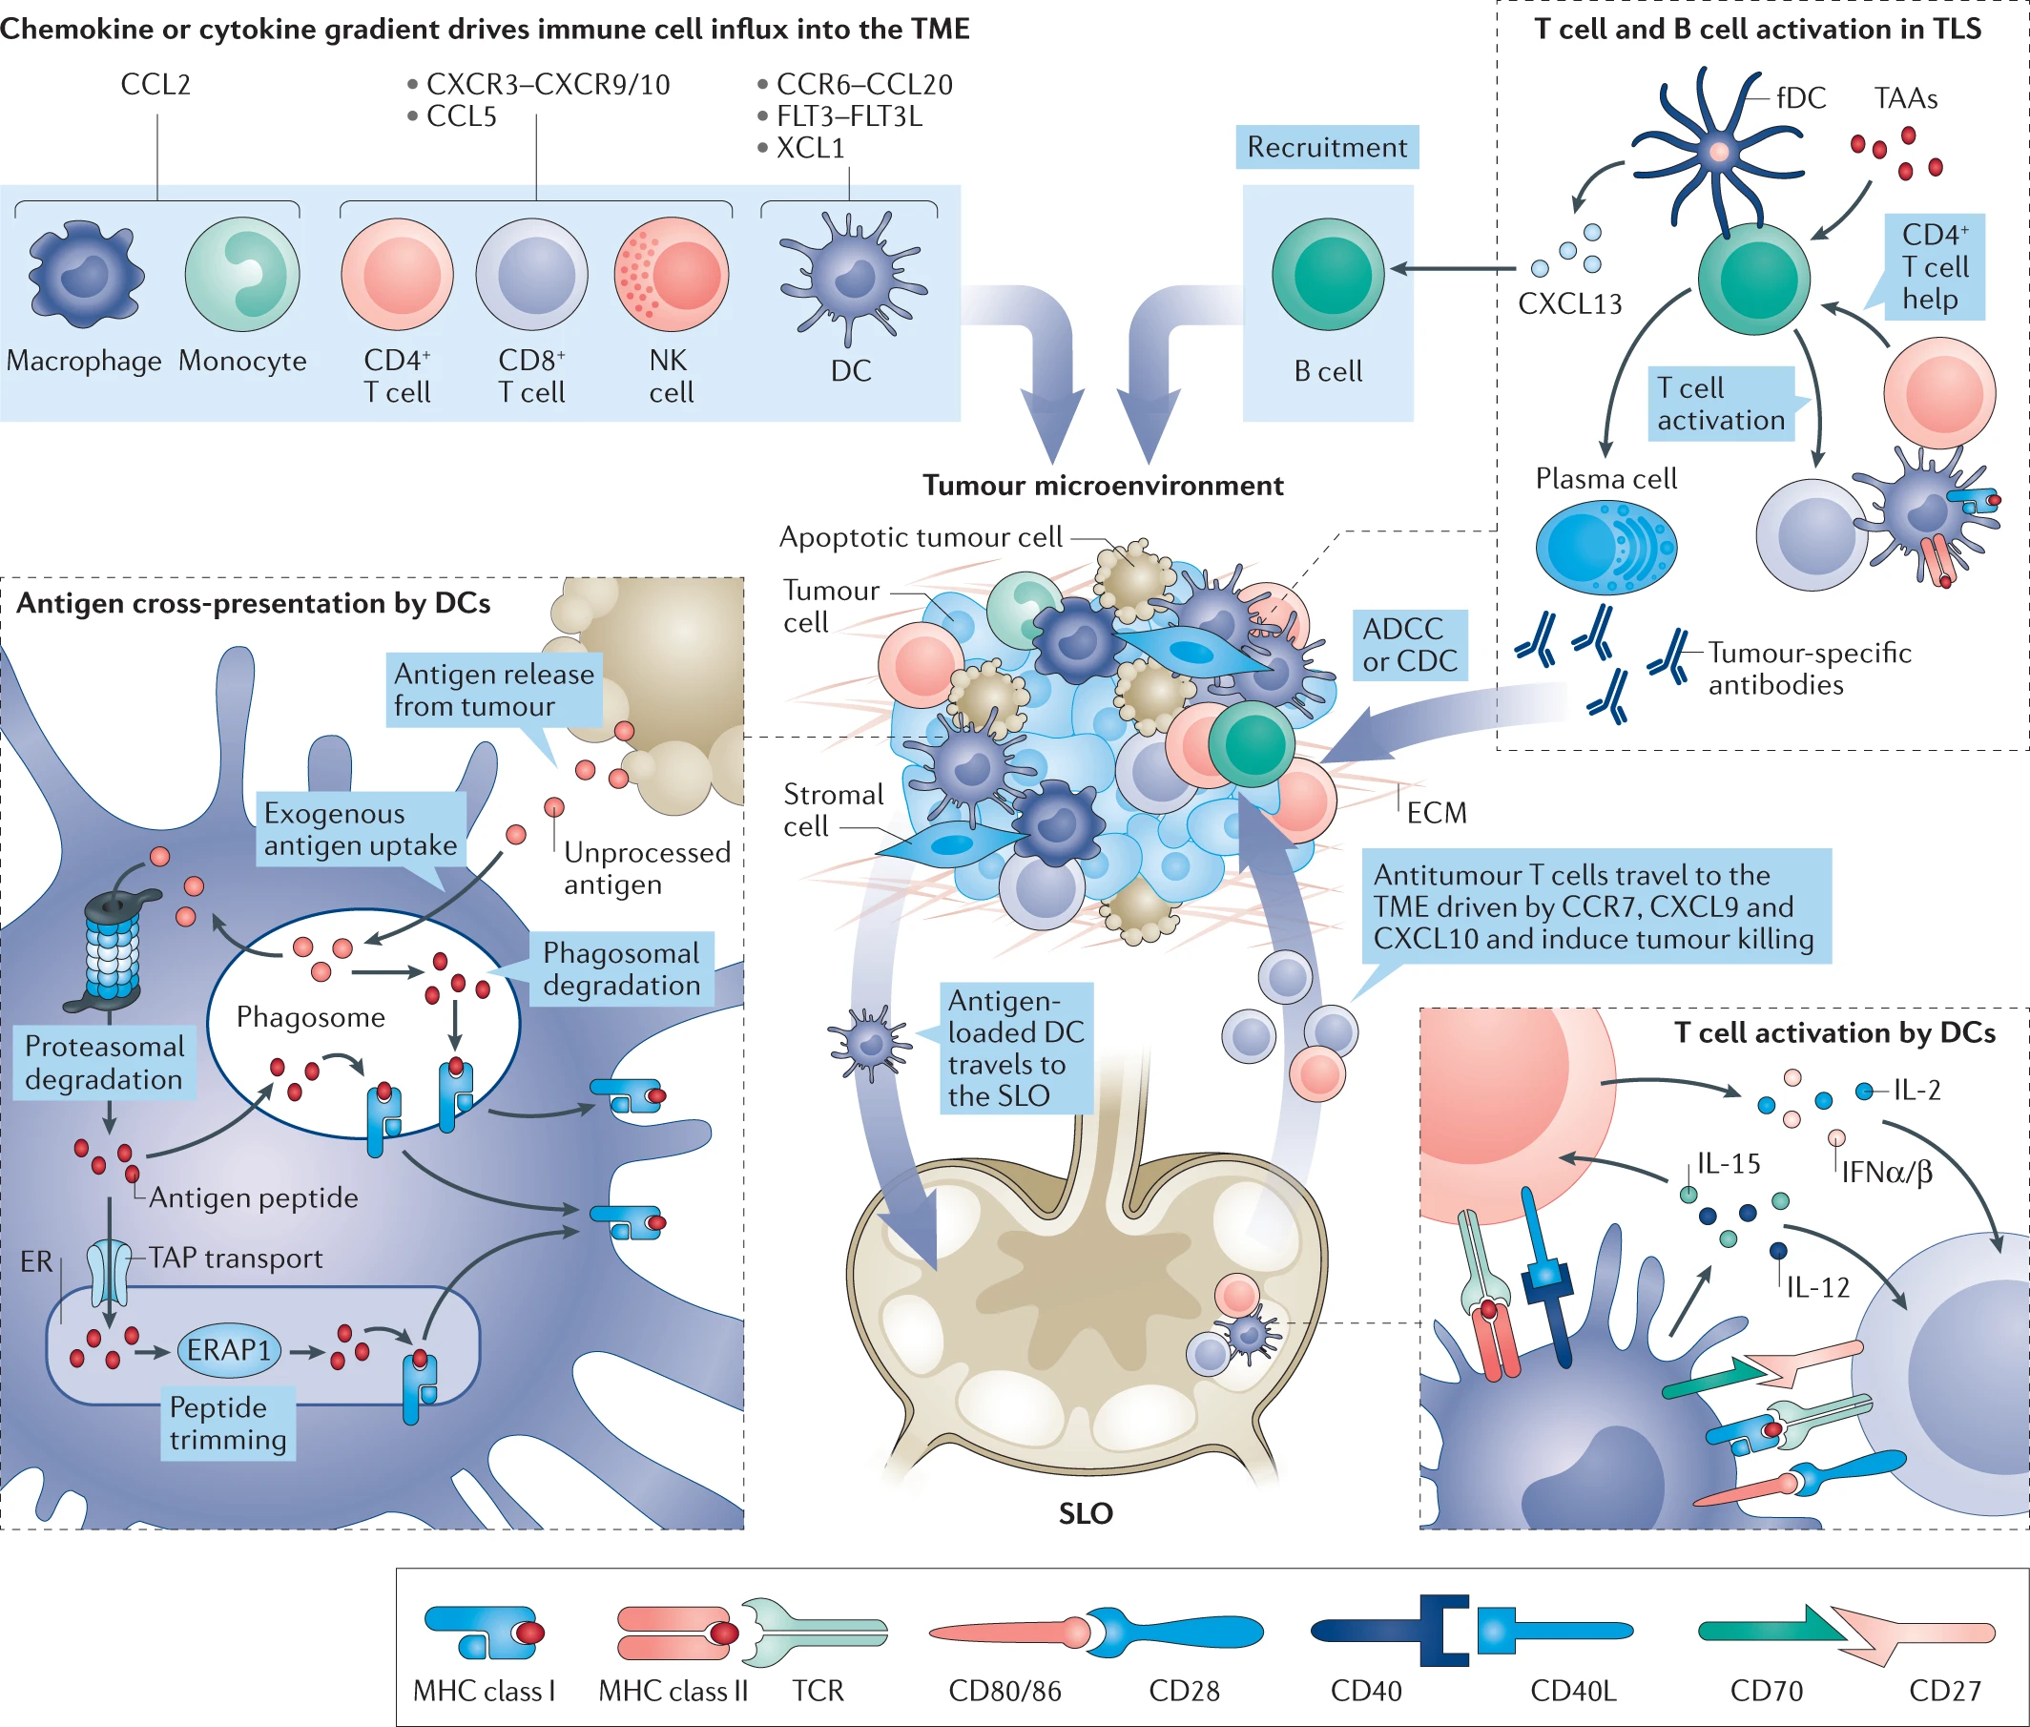
Fig. 1: Tumour immunity regulation

Slide 84
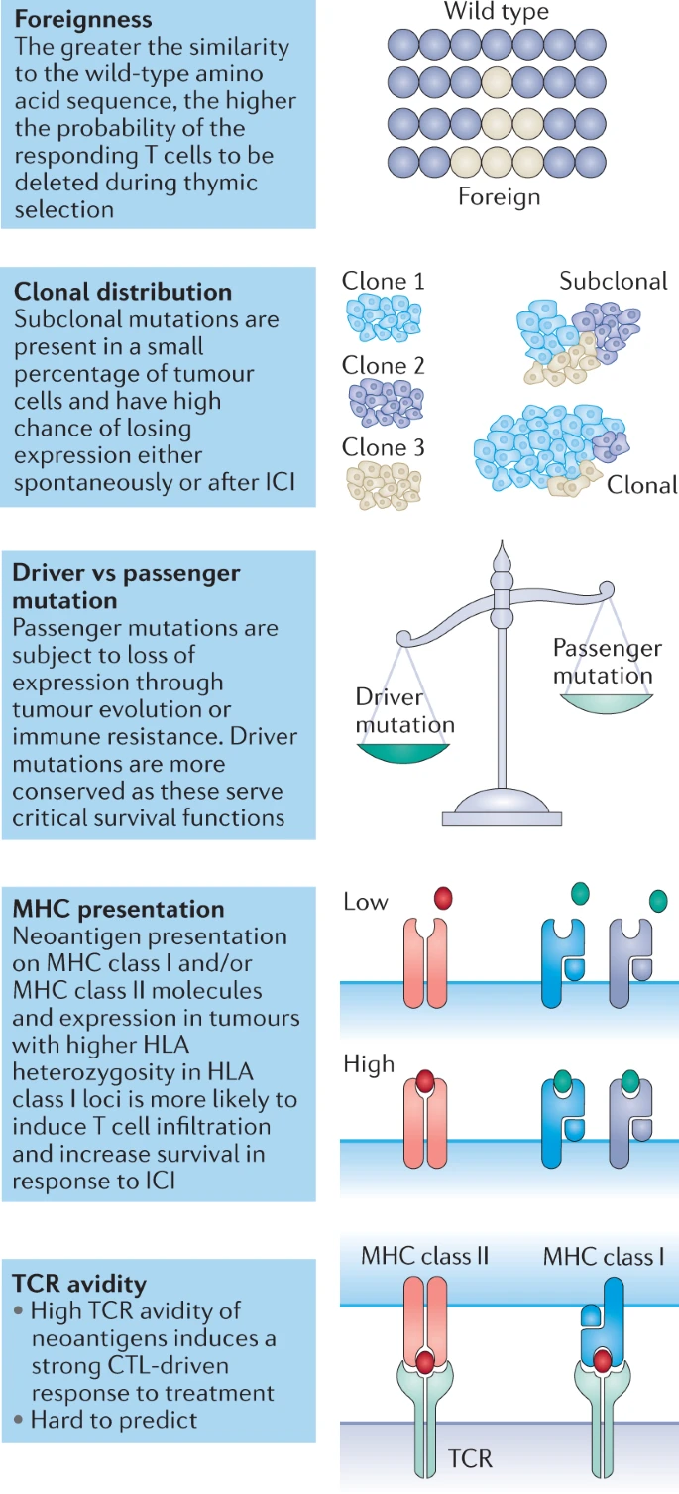
Fig. 2: Qualities of neoantigens

Slide 85
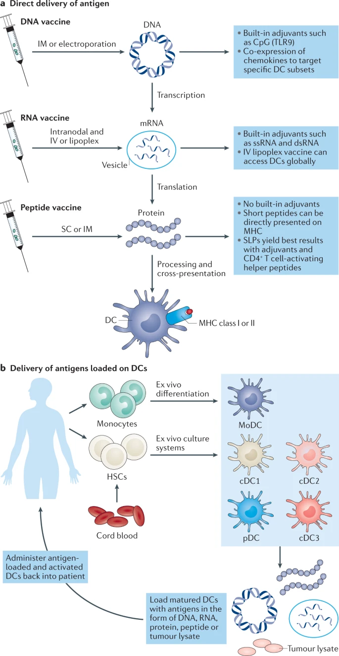
Fig. 3: Simplified depiction of cancer vaccine delivery platforms

Slide 86
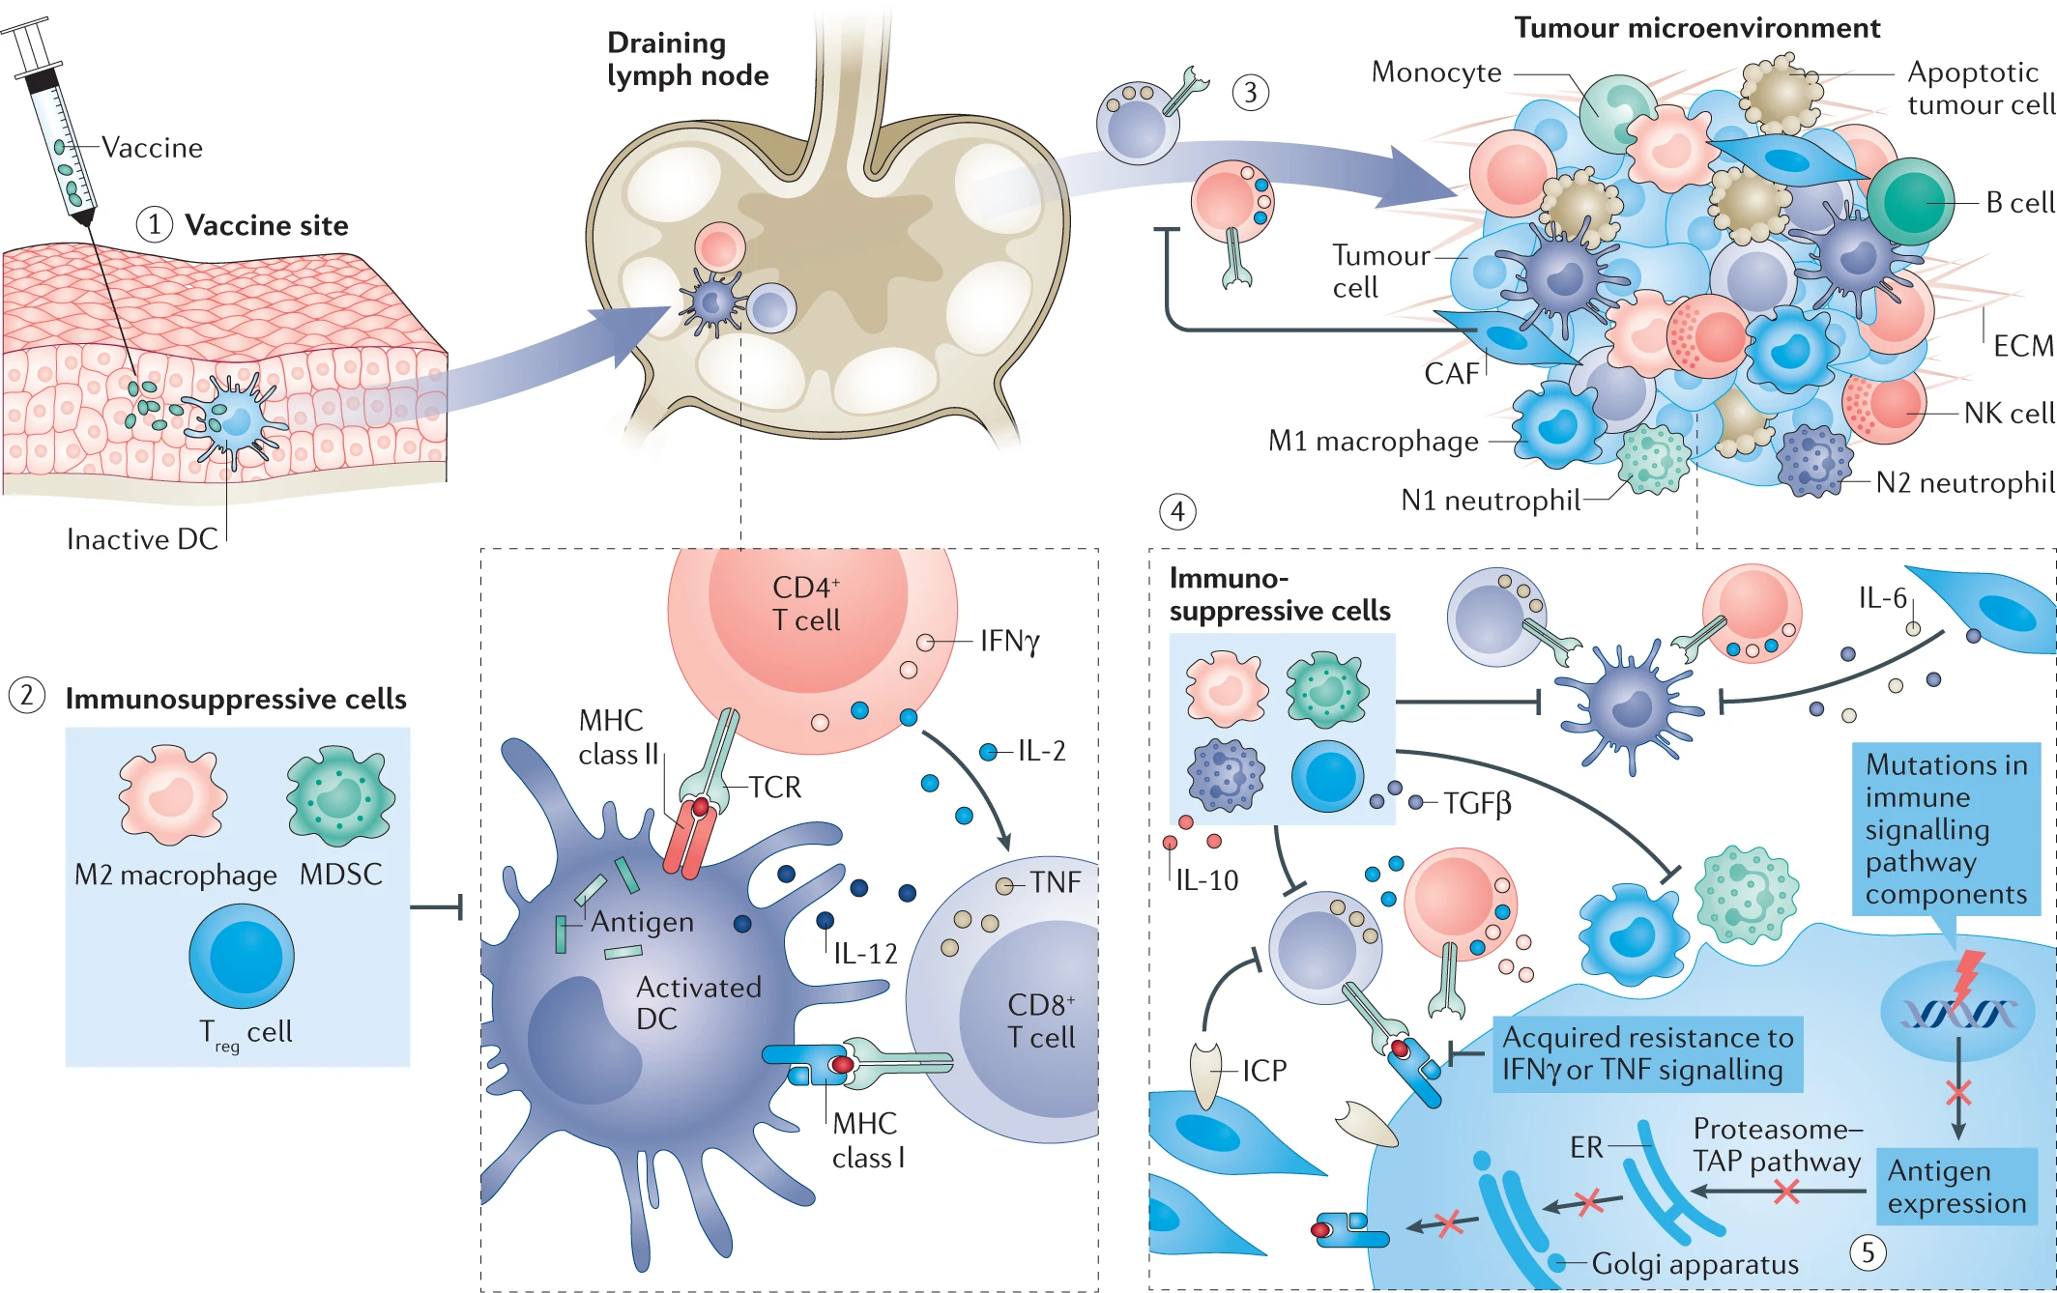
Fig. 4: Mechanisms of resistance to vaccine therapy

Slide 87
Advances in the development of personalized neoantigen-based therapeutic cancer vaccines
Eryn Blass &
Patrick A. Ott
Nature Reviews Clinical Oncology volume 18, pages215–229 (2021)

Slide 88
Personalized therapeutic cancer vaccines predicated on neoantigens have been shown to be feasible, safe and immunogenic in patients with melanoma and glioblastoma.
Different vaccine formats and delivery strategies are currently being tested in clinical studies involving patients with various tumour types.
Deeper evaluation of the phenotypes, functionality and long-lasting memory potential of vaccine-induced neoantigen-specific CD4⁺ and CD8⁺ T cells is warranted to improve understanding of their therapeutic activity and optimize vaccination strategies.
Neoantigen target discovery is continually being advanced to improve the identification of immunogenic neoepitopes that can be recognized by CD8⁺ T cells; algorithms for the more challenging task of predicting CD4⁺ T cell neoepitopes are also emerging.
Innovative vaccine delivery platforms and the most effective timing of combinatorial therapies should be further explored to reduce costs and time delays and increase clinical efficacy.

Slide 89
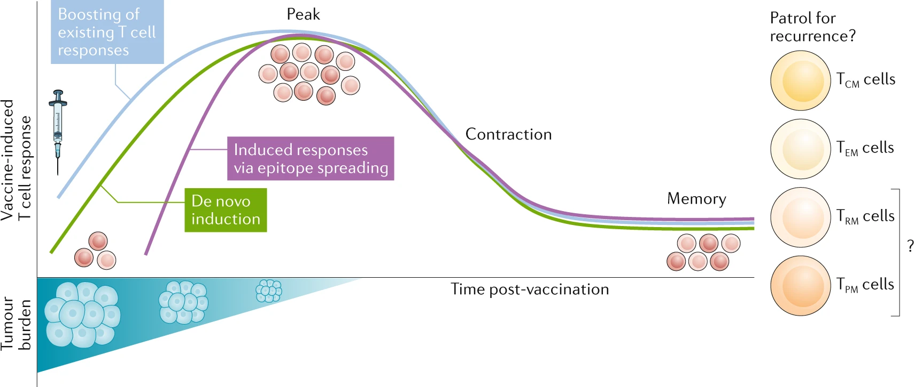
Fig. 1: Personalized neoantigen-based vaccination has the potential to induce long-lasting tumour-specific memory T cell populations

Slide 90
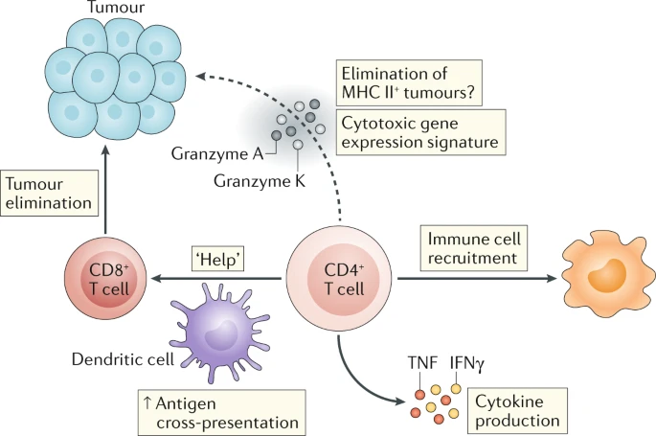
Fig. 2: Roles of neoantigen-specific CD4⁺ T cells following therapeutic vaccination

Slide 91
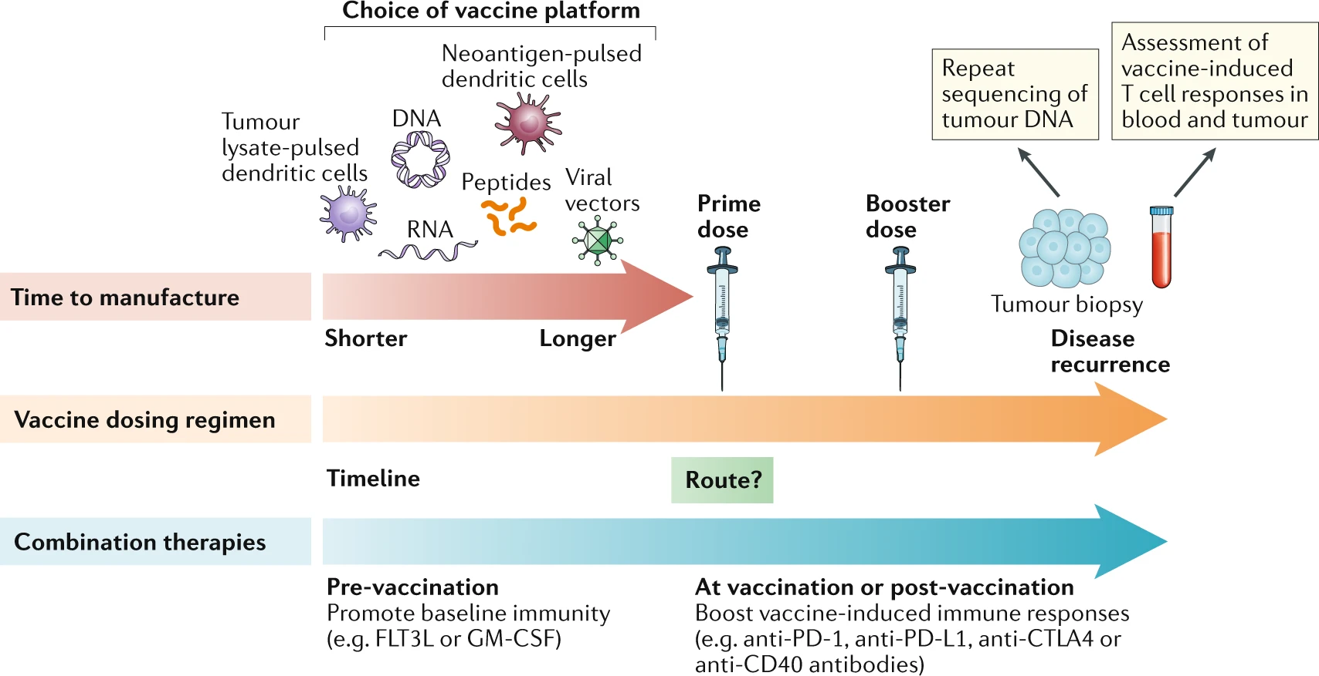
Fig. 3: Considerations relating to therapeutic neoantigen vaccine regimens

Slide 92
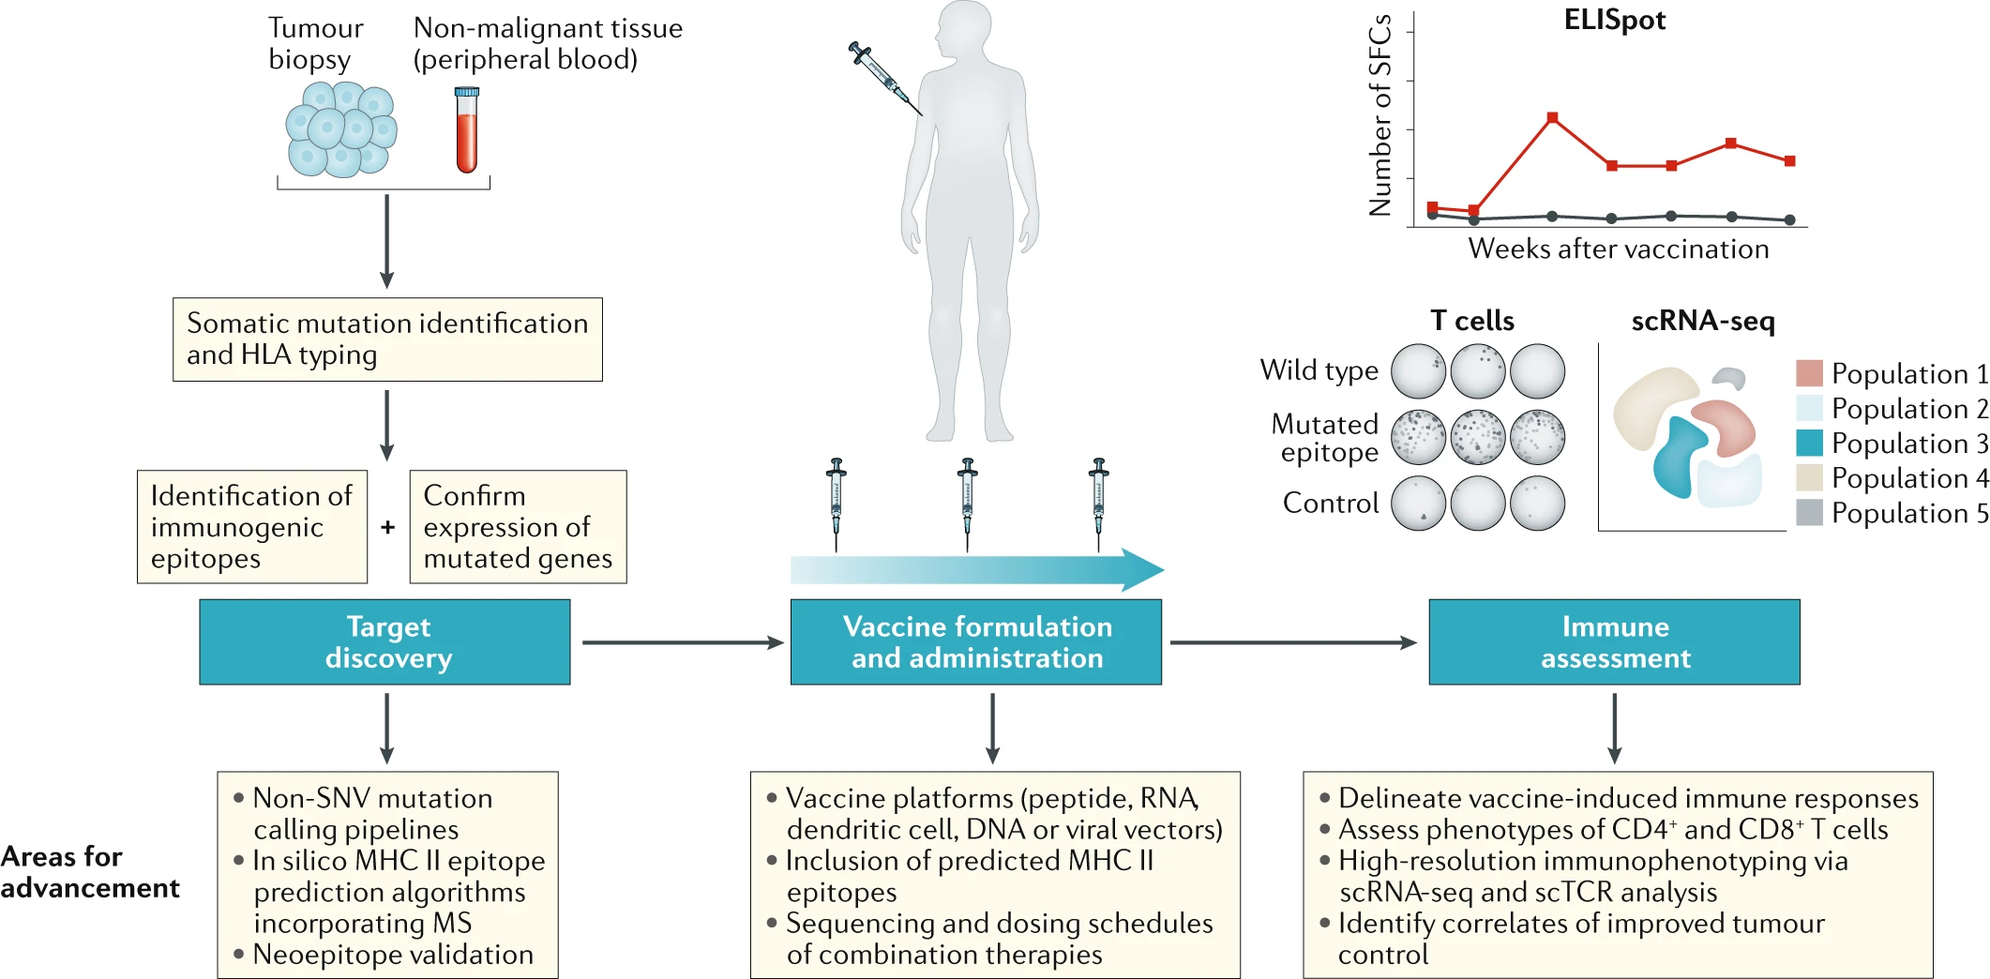
Fig. 4: Algorithm-based identification of neoantigens for use in therapeutic vaccines

Slide 93
Targeting a neoantigen derived from a common TP53 mutation.
Hsiue EH et al.
Science. 2021 Mar 5;371(6533):eabc8697.

Slide 94


Slide 95

FIG. 1 Biological and biophysical characteristics of scFv clone H2.

Slide 96

FIG. 2 H2-scDb activates T cells in the presence of tumor cells presenting p53^{R175H}
(A) Illustration depicting the mechanism of action of H2-scDb. (B) HLA-A*02:01–positive tumor cell lines with different HLA expression and p53^{R175H} status were co-incubated with H2-scDb and T cells at an E:T ratio of 2:1. IFN-γ release was measured with ELISA. Data indicate mean ± SD of six technical replicates and are representative of two independent experiments. The HLA-A*02 MFI ratio is defined as MFI (anti–HLA-A*02)/MFI (isotype control).

